Slide 1

ConnectSomerset.org.uk
Notes:
Connect Somerset has launched to improve early help in the community. Connect Somerset is about all professionals and community groups working together to help families and residents to improve their lives. ​
​

Slide 2
Connect Somerset is a partnership between Somerset Council, Somerset NHS, Voluntary, Community, Faith and Social Enterprises, and Schools, Colleges and Early Years settings
Notes:
Connect Somerset is how we work together across public, voluntary, faith and community sectors to improve the lives of families and residents.​
We’re in the same team — working in the same patch and getting to know each other. It’s about building relationships between professionals and having a phone call or a chat. Rather than referring a family from one professional to another, we build trusting relationships and bring in additional support to wrap around the family, whilst keeping that positive relationship.​
There is a fantastic network of hubs and community resources, such as Warm Welcomes. We work through these hubs with an offer of help for families and residents, and pulling the workforces together across the public and community sectors. Hubs have their own services and support, such as community hubs or libraries or a school. And we also have local professionals such as the Village Agent, Health Coach or Parent Family Support Advisor who are able to offer help and navigate the system, and Area Leads who shape delivery. Somerset is big and rural, so a network of spokes offer help at set times in areas where there have been gaps in services. Help might include drop-ins such as from citizens’ advice, housing, special educational needs and disability services, etc.​
Through Connect Somerset, we are getting rid of barriers and making it easier for professionals and communities to work together. For example, by streamlining processes, sharing data between people working with families and residents, aligning service areas so we’re working with the same people, and getting information about local resources and services online in one place to search. We’re improving mechanisms such as the team around the school and social prescribing, to improve how we work with teachers and GPs. And integrating across health and care, children’s and adults, people and place.​
We’re increasing the amount of early help that is there for residents, improving our understanding of needs and how we can target support, and being proactive by reaching out compassionately to offer help. Connecting the most vulnerable adults, older people, children and families to local community resources. You can only ‘reduce demand’ if we first increase demand, address inequalities and support more people earlier to achieve their outcomes. So we are orientating public services around a community-centric model — recognising this is the first place we all get our resilience from. And we’re improving the efficiency of how services work together so delivery will be more sustainable.​
Finally, we have a clear vision for how we can help improve local help, residence and community resilience, and services that are closer to home. But this is not a shiny new idea, this is about building and connecting together across the amazing hubs, community groups and public and voluntary services across Somerset.​

Slide 3


Importance of communities...
“Building community power is essential... for two reasons.
First, tackling deprivation is urgent, so we need to harness and mobilise every contribution that can be made and there are resources, relationships, assets, energy and compassion to tap into in neighbourhoods.
Second, community life can reach parts that the state cannot, and provide the relationships, purpose and connection that make it more likely that life goes well.
“But this is not about the state getting out of the way. This work will only succeed where community power meets a like-minded local state. That requires an openness to shifting culture and ethos toward more relational, human centred and no-wrong-door ways of working that support people to get the help they need when they need it, rather than being told to come back when a threshold has been surpassed.
It also requires a commitment to building community wealth and power, to make a sustained impact on reducing hardship.”
Notes:
Blog: www.jrf.org.uk/blog/design-out-deep-poverty-strengthen-social-safety-net ​

Slide 4






Cost-of-living crisis for residents
17.7%
Households with food insecurity
45%
Somerset adults finding it difficult to pay bills – that’s 216,000 people
Those most marginalised in society have least ability to weather the cost-of-living crisis
21,000
Children in poverty
90%
Families on Universal Credit cannot afford basics
6%
Not eaten for a day in last month because of cost
9.5 years
Deprivation gap for male length of life, 7.7 years for females
49%
Spending more on energy, 44% spending more on food
19%
Supermarket inflation in
one year
Notes:
The cost-of-living-crisis adds to covid and other pressures on families and residents. Leading to increasing demand, often at a much later date. Connect Somerset is part of our response to families.​
We’re worried about how the rising cost of living, fuel, food will affect children, young people and their families (figures in diagrams are mostly national)​
Already seeing more complex needs coming through, linked to how covid-19 added stress to families. ​
Likely to see children and young people not previously know to services requiring statutory support. ​
Increasing demand to acute services across partnership.​
Need to quickly make changes in Somerset early help to support these families.​

Slide 5
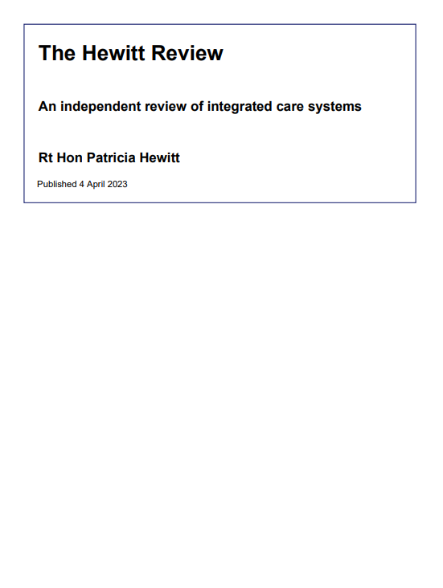

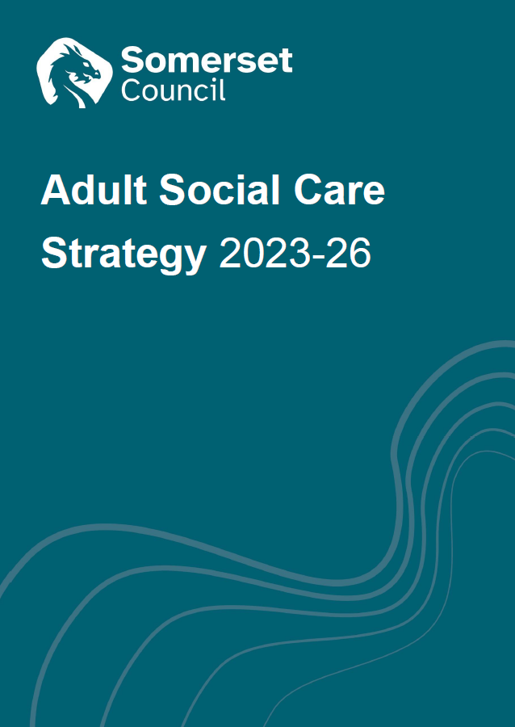


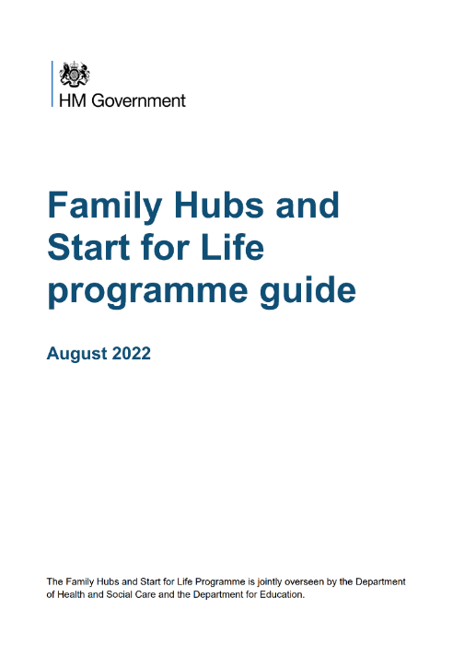

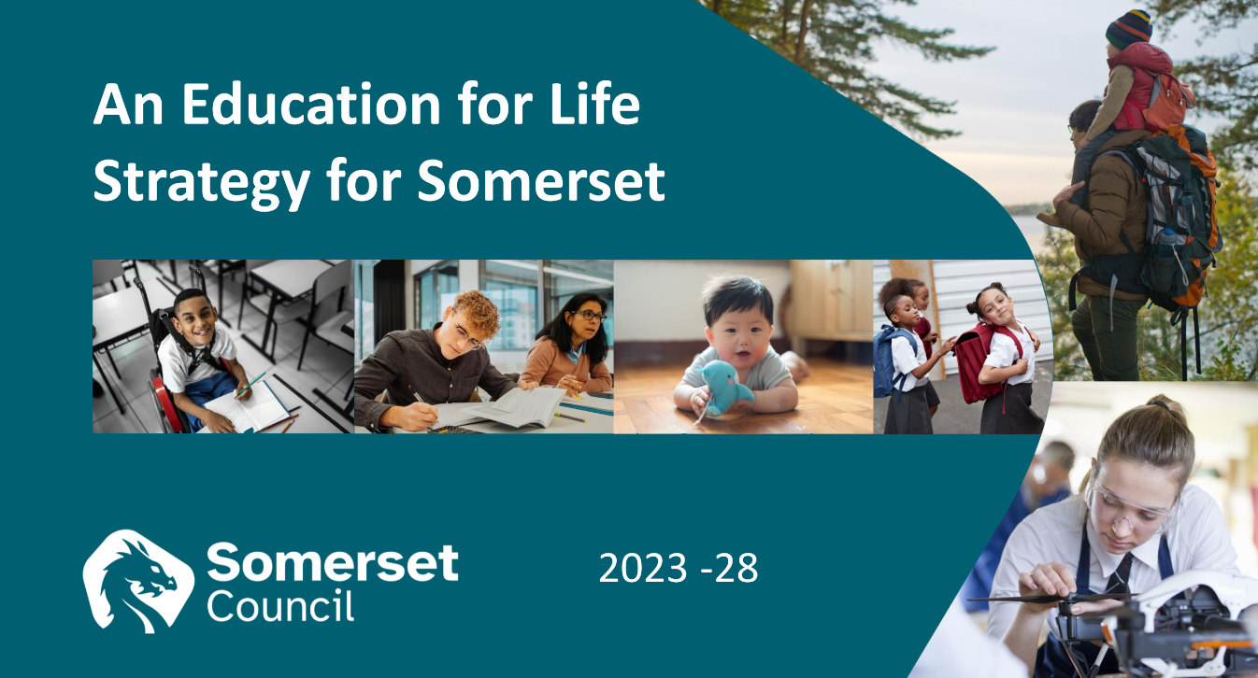
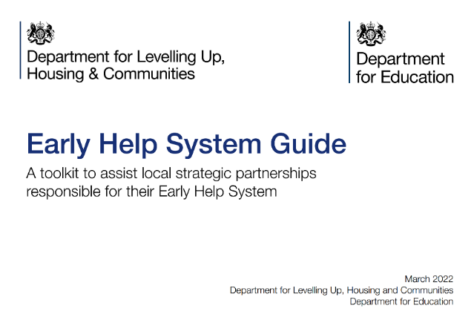

Context
Notes:
We’re building on key policies and strategies from DH, DfE, DLUHC and our own Council and ICS.​
Council plan – priorities include ‘A Healthy and Caring Somerset’, ‘A Flourishing and Resilient Somerset’, ‘A Fairer ambitious Somerset’​
Education for Life strategy – ambitious strategy to improve the Somerset Education system and children’s services across the partnership​
DHSC Fuller stocktake – primary care and communities should integrate as leads to better outcomes and reduced inequality​
DLUHC Early Help System Guide – integrate at the community level to improve families’ lives. Endorsed by DfE.​
DfE Family Hubs – local hubs and service offer with partners. Themes of Access, Connected and Relationships.​
ICS Fit for My Future vision – to integrate health and care services with an all-age model of support​
Also LGR – health and care integration is an underpinning design principle to improve efficiency of public sector delivery​

Slide 6
Demand
Demand
Service
Notes:
Important when we’re discussing an early help model that we have a clear understanding of ‘demand management’.​
This is a representation of an ideal service model where demand for support equals the service volume​
But we all know it’s not quite like that, especially given the c. 50% reduction in real-terms spend since 2010​

Slide 7
Challenge
Demand
Service
Notes:
So the service shrinks, demand grows, and we put up thresholds and barriers to success. This is a sub-conscious organisational response.​
Two things:​
There isn’t a balance – eventually demand will overwhelm the service. This statutory minimum service model will break if we don’t put enough money into it.​
If you are one of the people waiting for a service or being pushed away – it feels very unkind. Which mirrors the deteriation in relationships between the public and public sector.​
Alternative is to find a way of supporting more people, earlier. Increasing demand so we can meet that demand in a more cost-effective way, and therefore reduce demand to expensive acute services.​

Slide 8
The early help system
Parent,
Family
Support
Advisors​
Early Help is the total support that improves a family or resident’s resilience and outcomes or reduces the chance of a problem getting worse
GP & Dentist
Sports & Leisure
Maternity services
Arts & Culture
Village Agent
Social Care & FIS
Library
Youth Services
Housing
A&E
Health Visitor
Community
School & Post-16 Education
Probation
SWAST Ambulance
Mental Health
Local Business
Voluntary, Faith and Community groups
CAFCASS
Alternative Provision
Youth Justice
Community Nursing
Nursery
Police
Benefits
Special Educational Needs
Family & Friends
Digital Support
Drug & Alcohol Misuse
Residential & Nursing Care
Jobcentre Plus
School Nurse
Place & Environment
PCN Neighbour-hood team
Prison
Speech & Language
Home care
Pharmacy
Fire & Rescue
Key:
Community
Universal
Acute & Targeted
One Team​
Notes:
This is how the early help system works. Lots of different agencies and organisations. ​
​
Most important part is in orange around the family and resident, it’s what we all experience that helps us to be resilient when things go a little wrong in our lives.​
​
Orange – Community​
Blue – Universal services​
Pink – Acute and targeted services which also provide early help​
Early Help is a big and complicated system, with maybe 20,000 to 30,000 people working in Somerset.​
​
Not going to tell everyone to adopt a new target operating model, as there is little direct control. It’s about how we connect professionals and communities, why we got into people services in the first place, how we can improve families and residents’ lives better by working together.​

Slide 9

Why talk about systems?
Dr Ackoff’s example of a car
Let’s build the best car in the world. Take the best brakes, best controls, best tyres, best gearbox, etc and put it together.
Is this the best car? Does it even work?
How do we manage services vs the system?
It can be counter-intuitive, but…
The system makes as much of
a difference as individual services
Notes:
The quality of each service is important, but the system is equally important. This is the focus of the transformation programme, but it’s often a cultural shift to try to conceptualise and then redesign the children and family system.
Example is from Dr Russell Ackoff:
Suppose you’re building the best car in the world. You would go about it by first bringing each of all the car models in the world to one place. You would then hire the best vehicle engineers and mechanics in the world and ask them to determine which of the cars has the best engine. If the engineers say that the Rolls-Royce has the best engine, you would pick the Rolls-Royce engine for your car. Similarly, you would ask your engineers to find out which of the cars has the best exhaust system and pick that for your future car. Using this method, you and your team would go through the necessary parts for building a car and in the end have a list of the best parts available in the world. You would then give the list to your engineers and mechanics and ask them to assemble the car. What do you think you will get?
The answer is obvious: you don’t even get a car! The parts won’t simply fit together. An engine from a Rolls-Royce won’t work well with an exhaust system from a Mercedes. The performance of the car is dependant on the interaction of its parts, not on the performance of the parts taken separately.
Demming estimated that 94% of performance is down to, or can best be improved by, the system. i.e. the performance of a system (such as early help) is how the parts fit and interact with each other, so we have to do the service design in tandem with the system design.

Slide 10
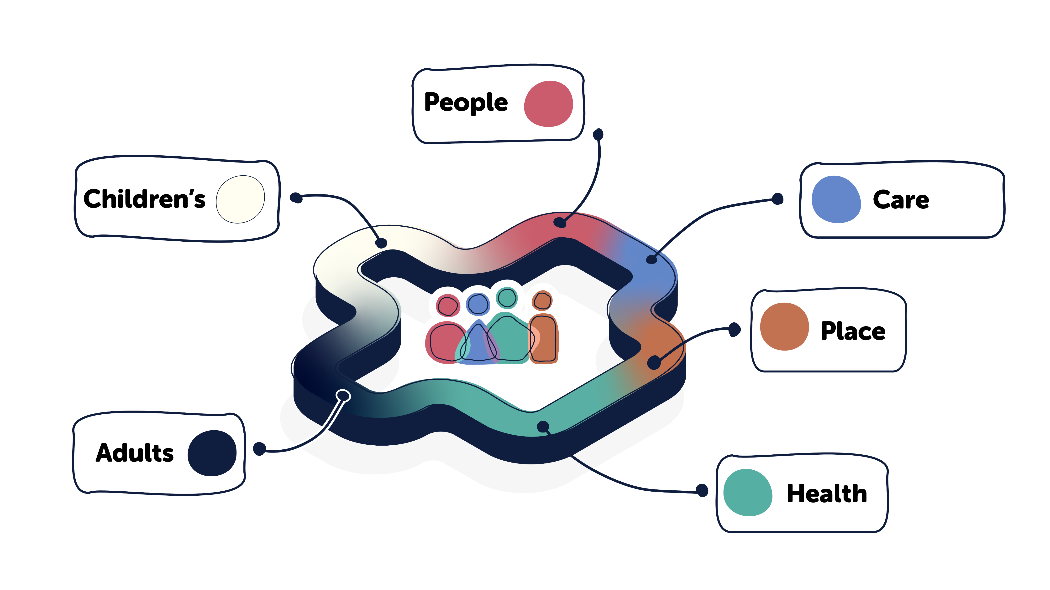








Integration
Notes:
Because of the complexity of the early help system, we need to pull it together to make sense to local residents and to have the most cost-effective impact. ​
​
Bringing together or integrating:​
​
Health and Care system​
Children and Adults services​
And People and Place – joining up people services with Local Community Networks and what happens in local communities, parishes, town councils​

Slide 11
Key messages
1
‌Help more residents and help them earlier
Support schools to be at centre of their community and draw on community resources
Enable residents and their families to be resilient and connected to their community
‌Integrate services and support, closer to home
Improve residents’ lives, reduce inequality and reduce demand for expensive acute services
2
3
4
5
Notes:
We’re building from lots of local and national learning. Here are the key messages we’re using to guide Connect Somerset.​
​
(Note alignment to themes from DfE family hubs: Access, Connect, Relationships)​

Slide 12
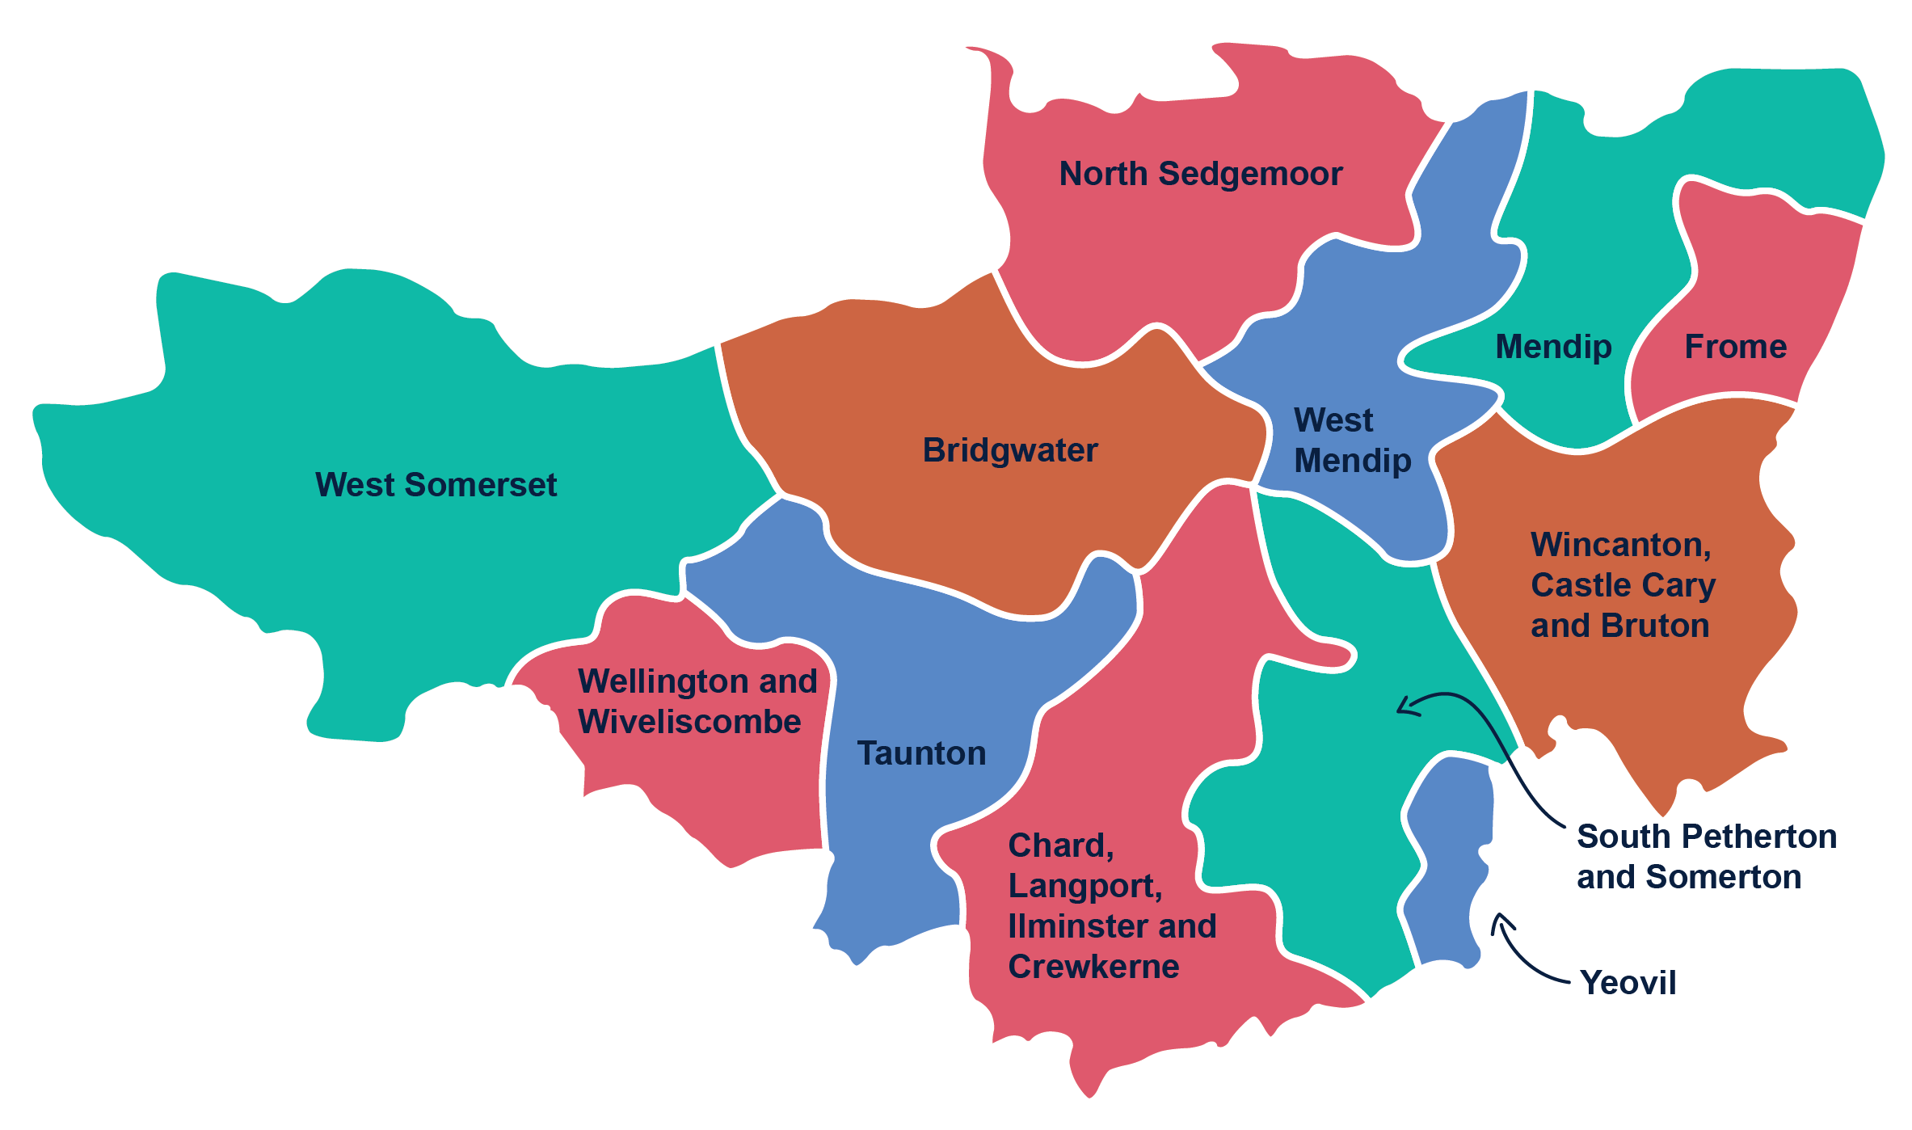
Neighbourhoods
Coterminous with Adult Services Neighbourhoods
Working very closely with Local Community Networks and School Clusters
Aligned with Primary Care Networks
Best alignment with system to maximise integration and more effective support for families and residents
Notes:
Alignment as much as possible across people services – to help unlock funding in the health and care system to benefit schools, children and their families​
Working very closely with Local Community Networks and School Clusters​
​​

Slide 13
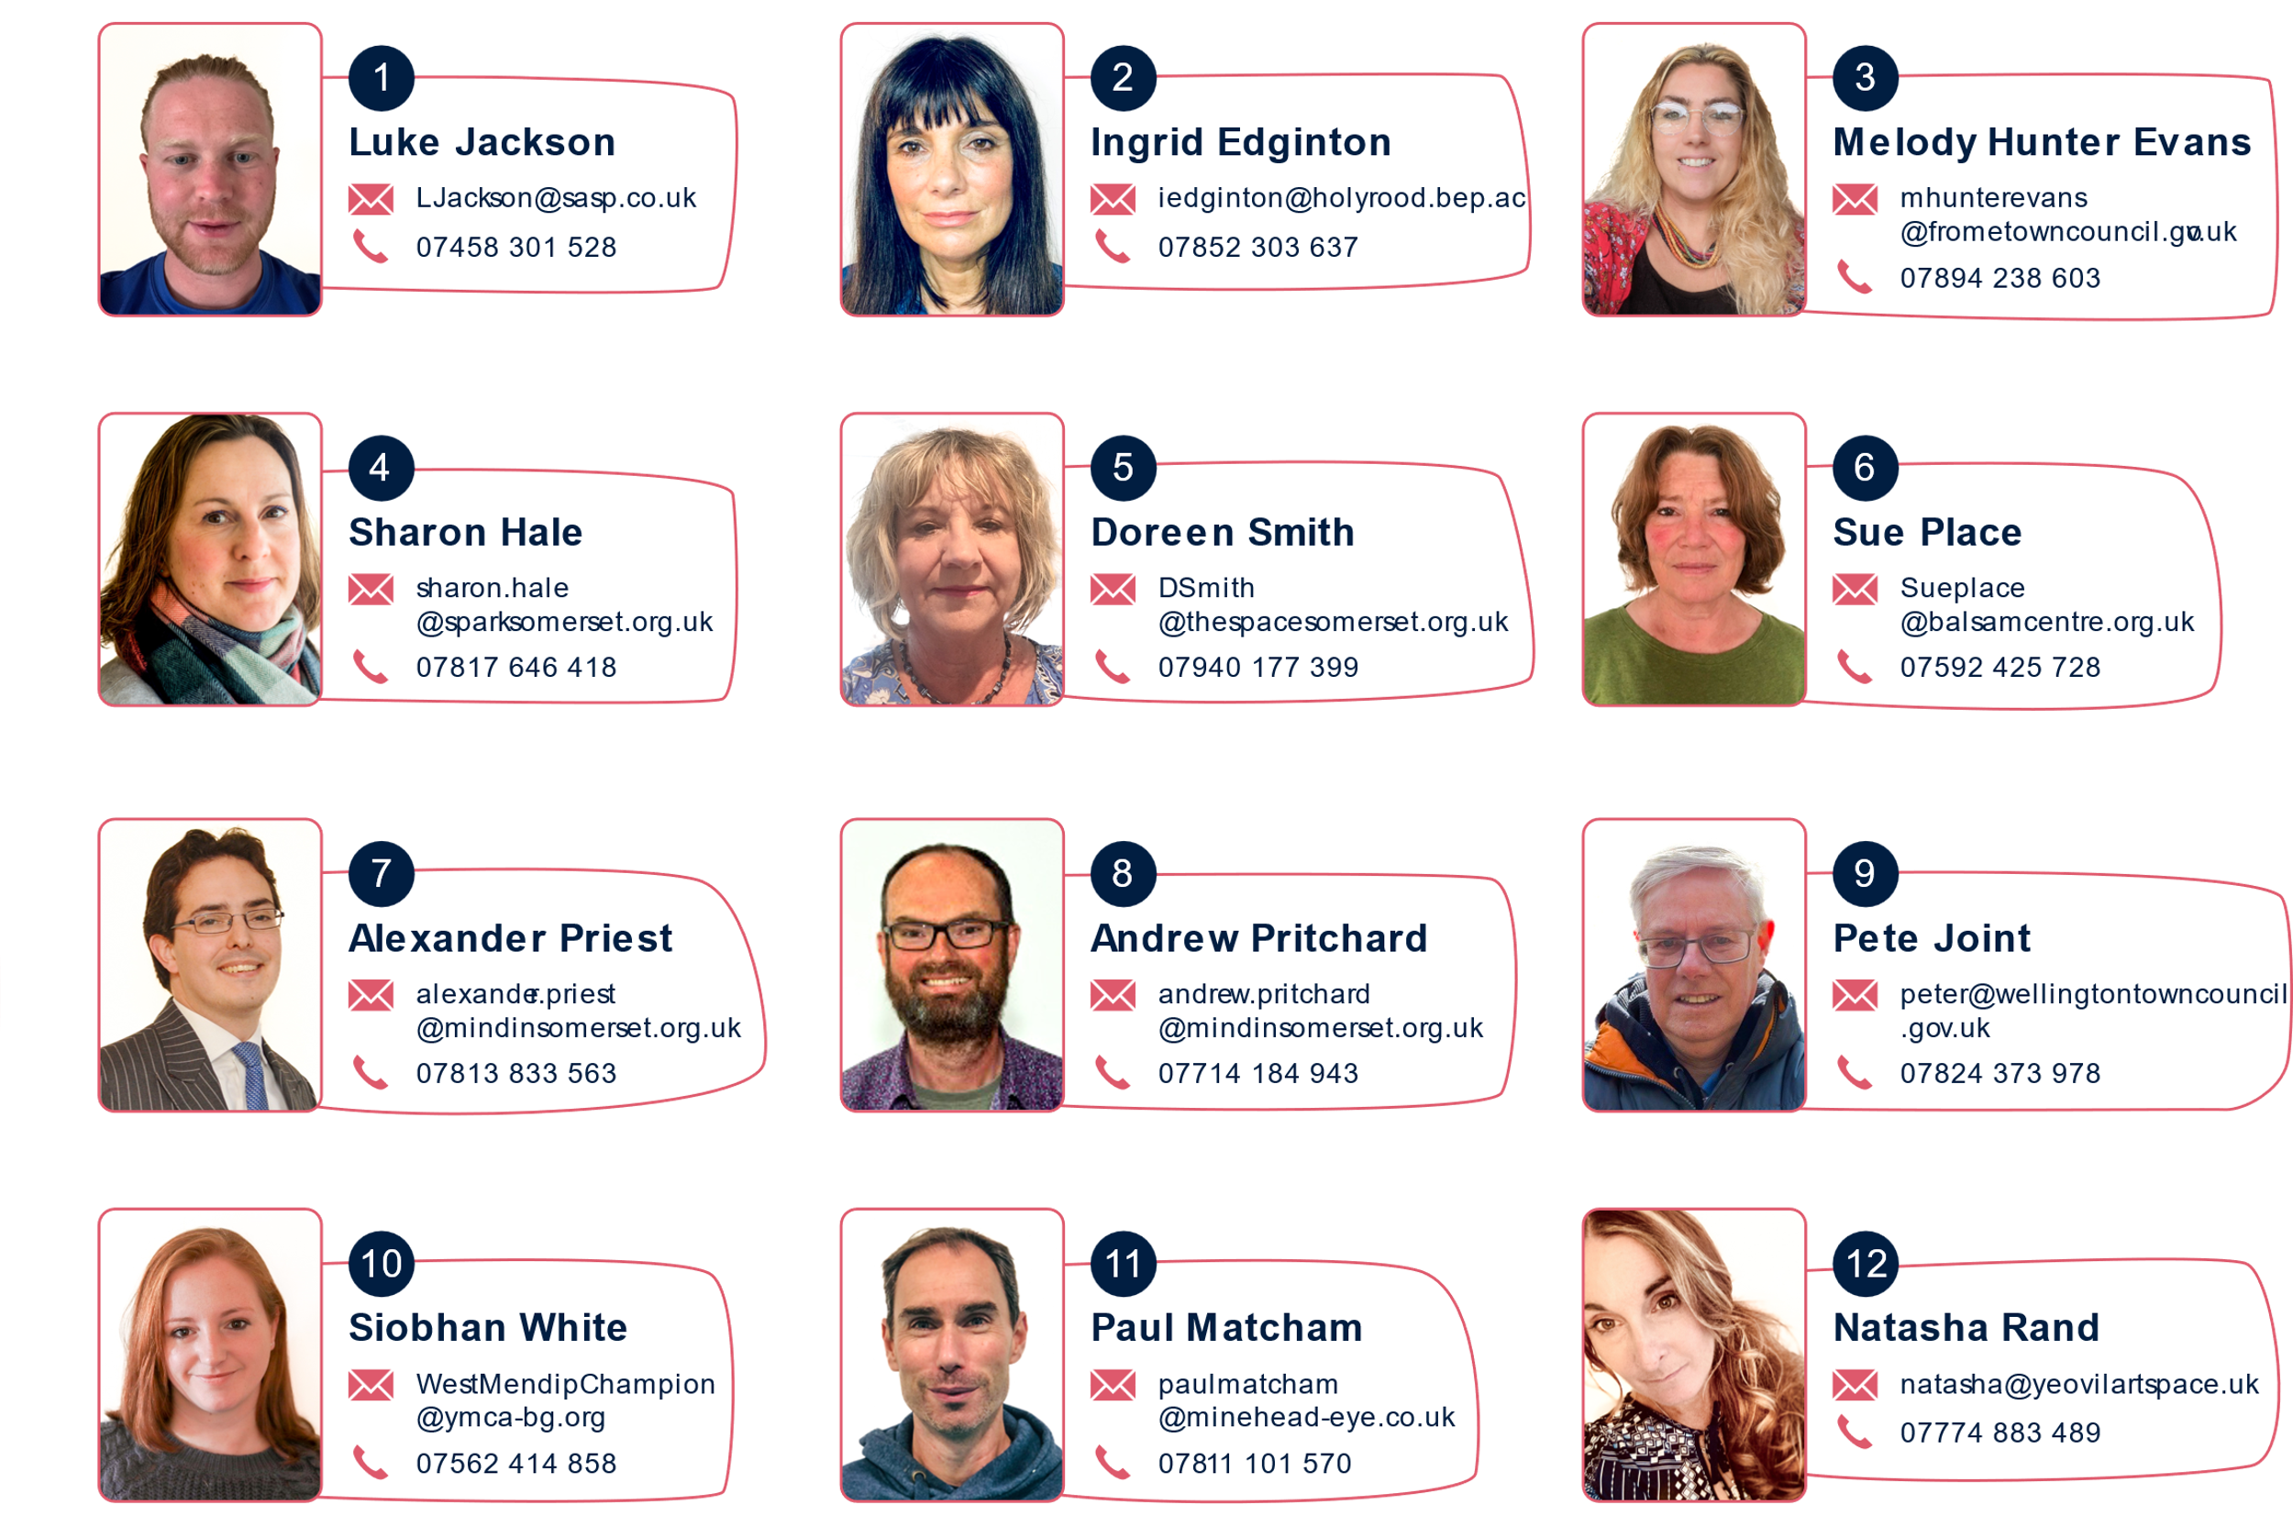
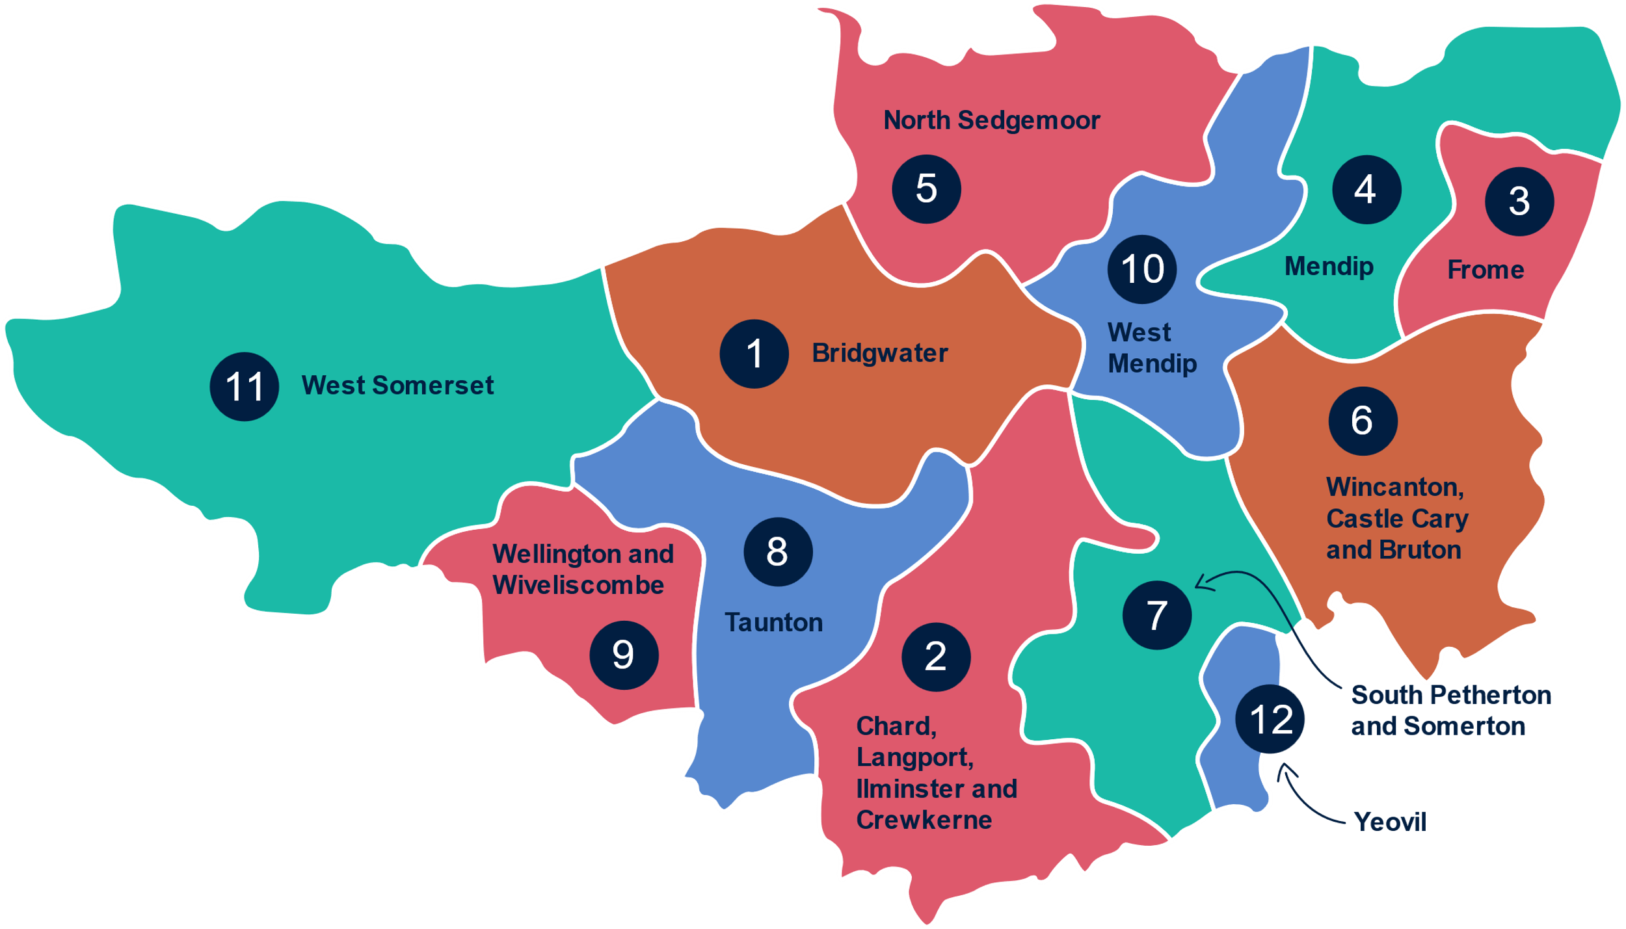
Find your Champion

Slide 14
Fantastic local hubs and resources
100 Warm Welcome hubs
273 Schools and Colleges
Community Hubs, Talking Cafés, etc
18 Local Community Networks
13 Primary Care Networks and Adult Social Care Neighbourhoods
2760 registered charities with 10,300 volunteers
Parent, Family Support Advisers,
Village agents, Community Agents, One Teams
Health Connections, Social Prescribing
Link Workers, Health Coaches
Public services in schools and early years settings, GP surgeries, libraries, social care, hospitals and community settings, health visiting, police, etc
Notes:
So much fantastic local resource that we want to work with to support families and residents.​
​
In the past, we’d have done a new model, built new hubs. Now we’re using what people are already accessing – more collaborative and accessible.​

Slide 15
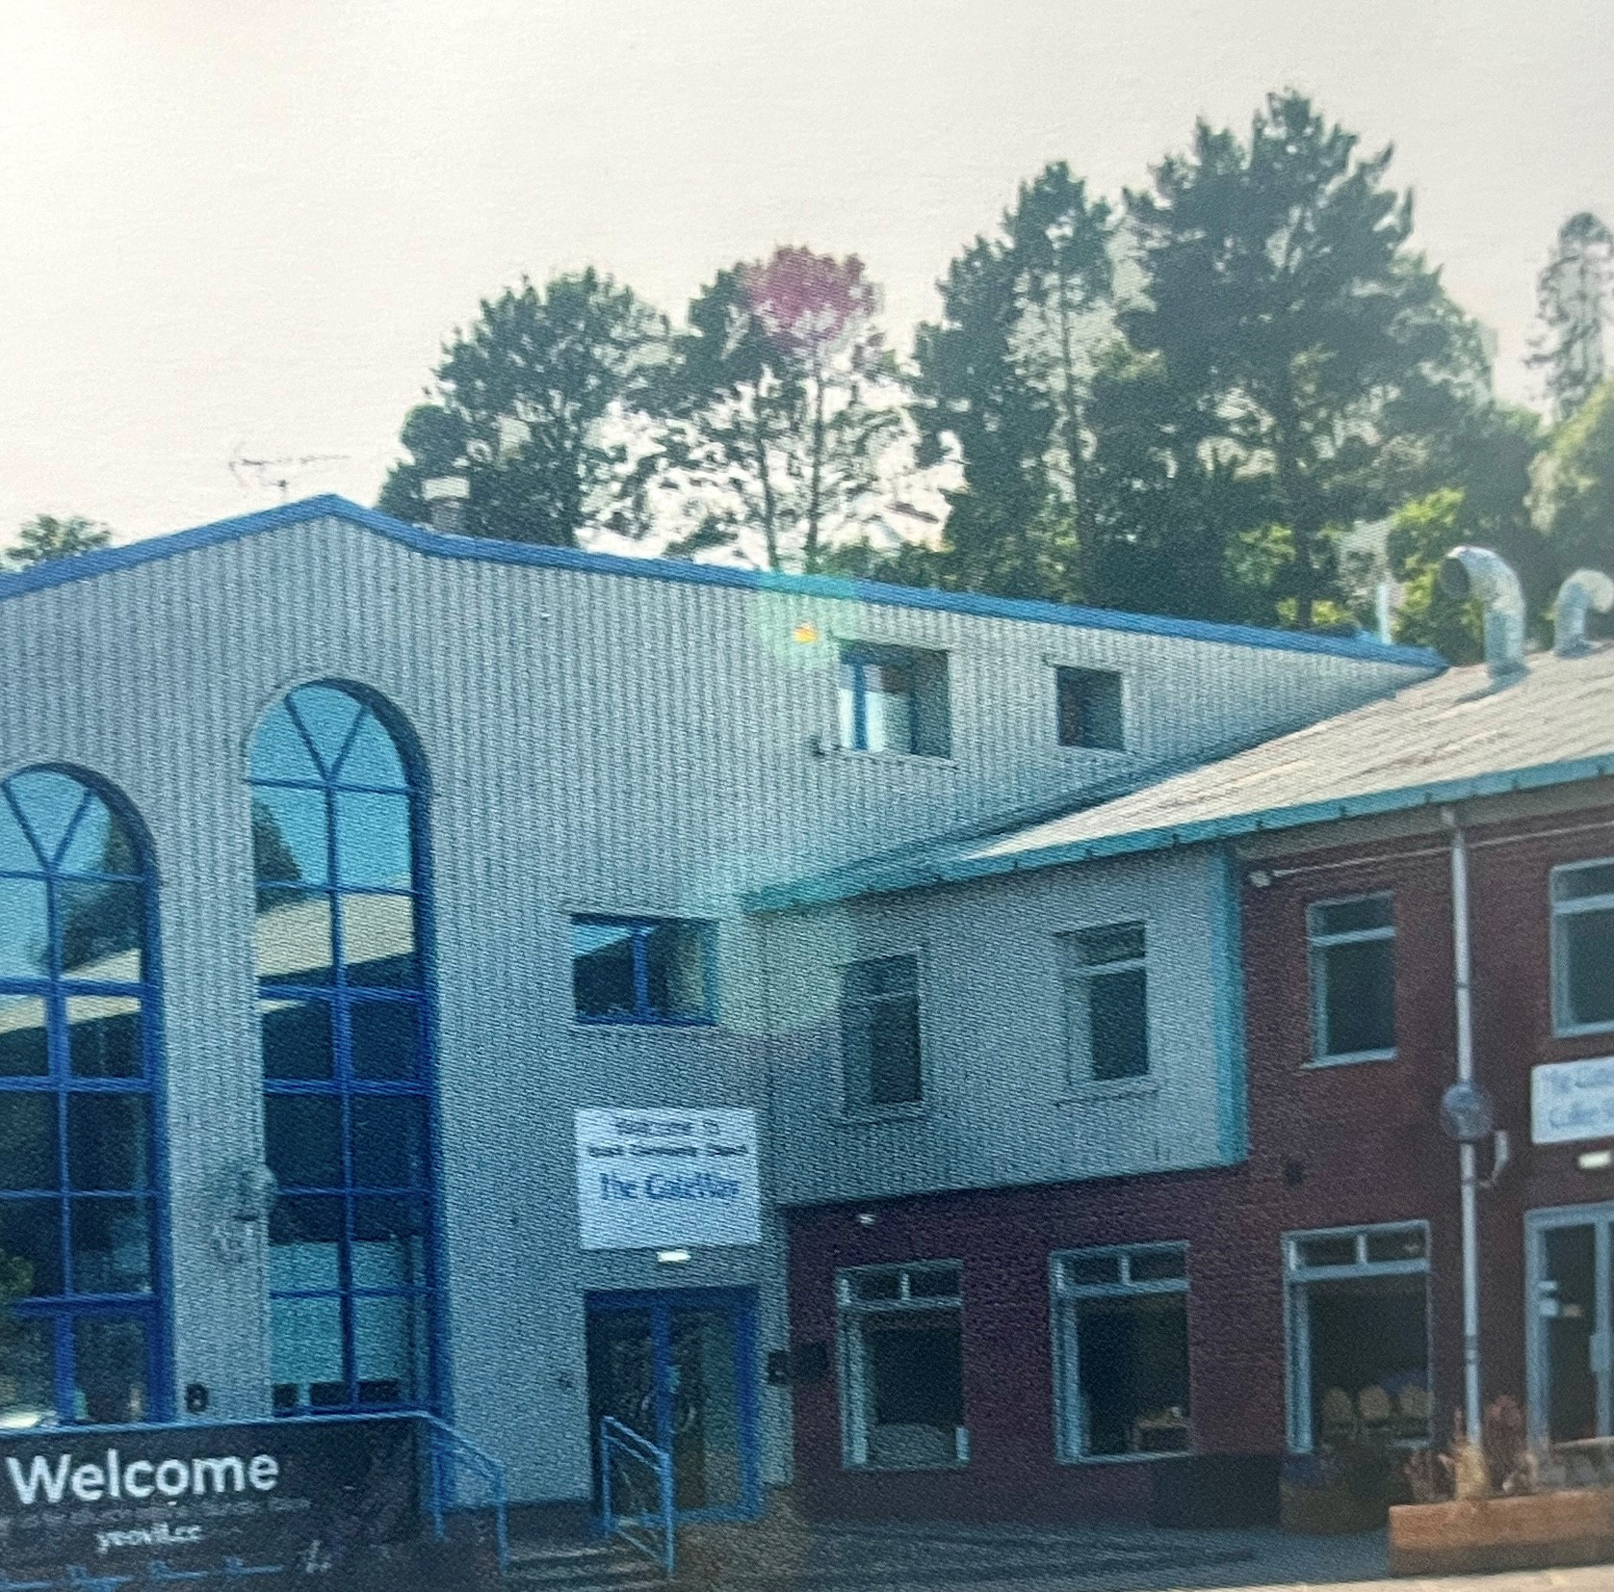
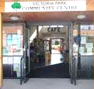
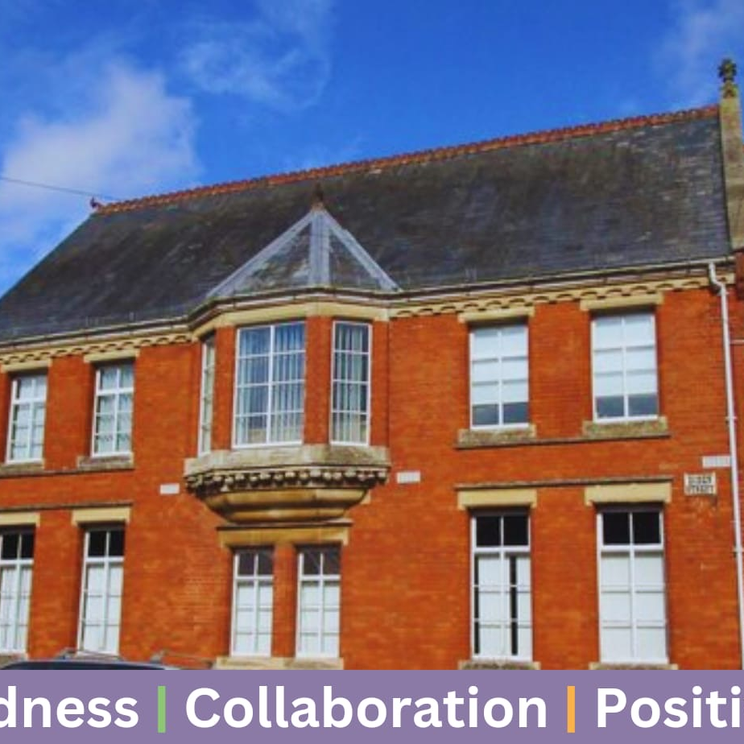
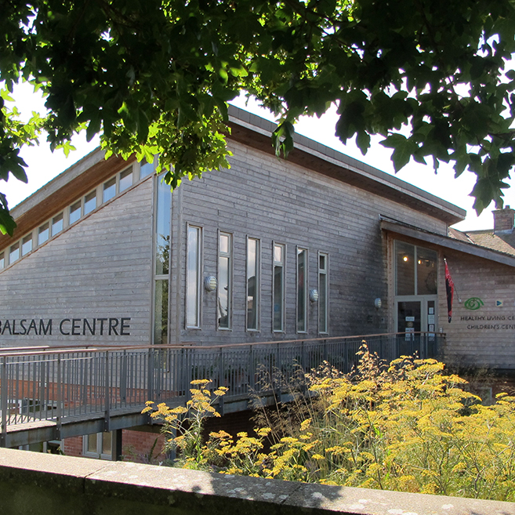
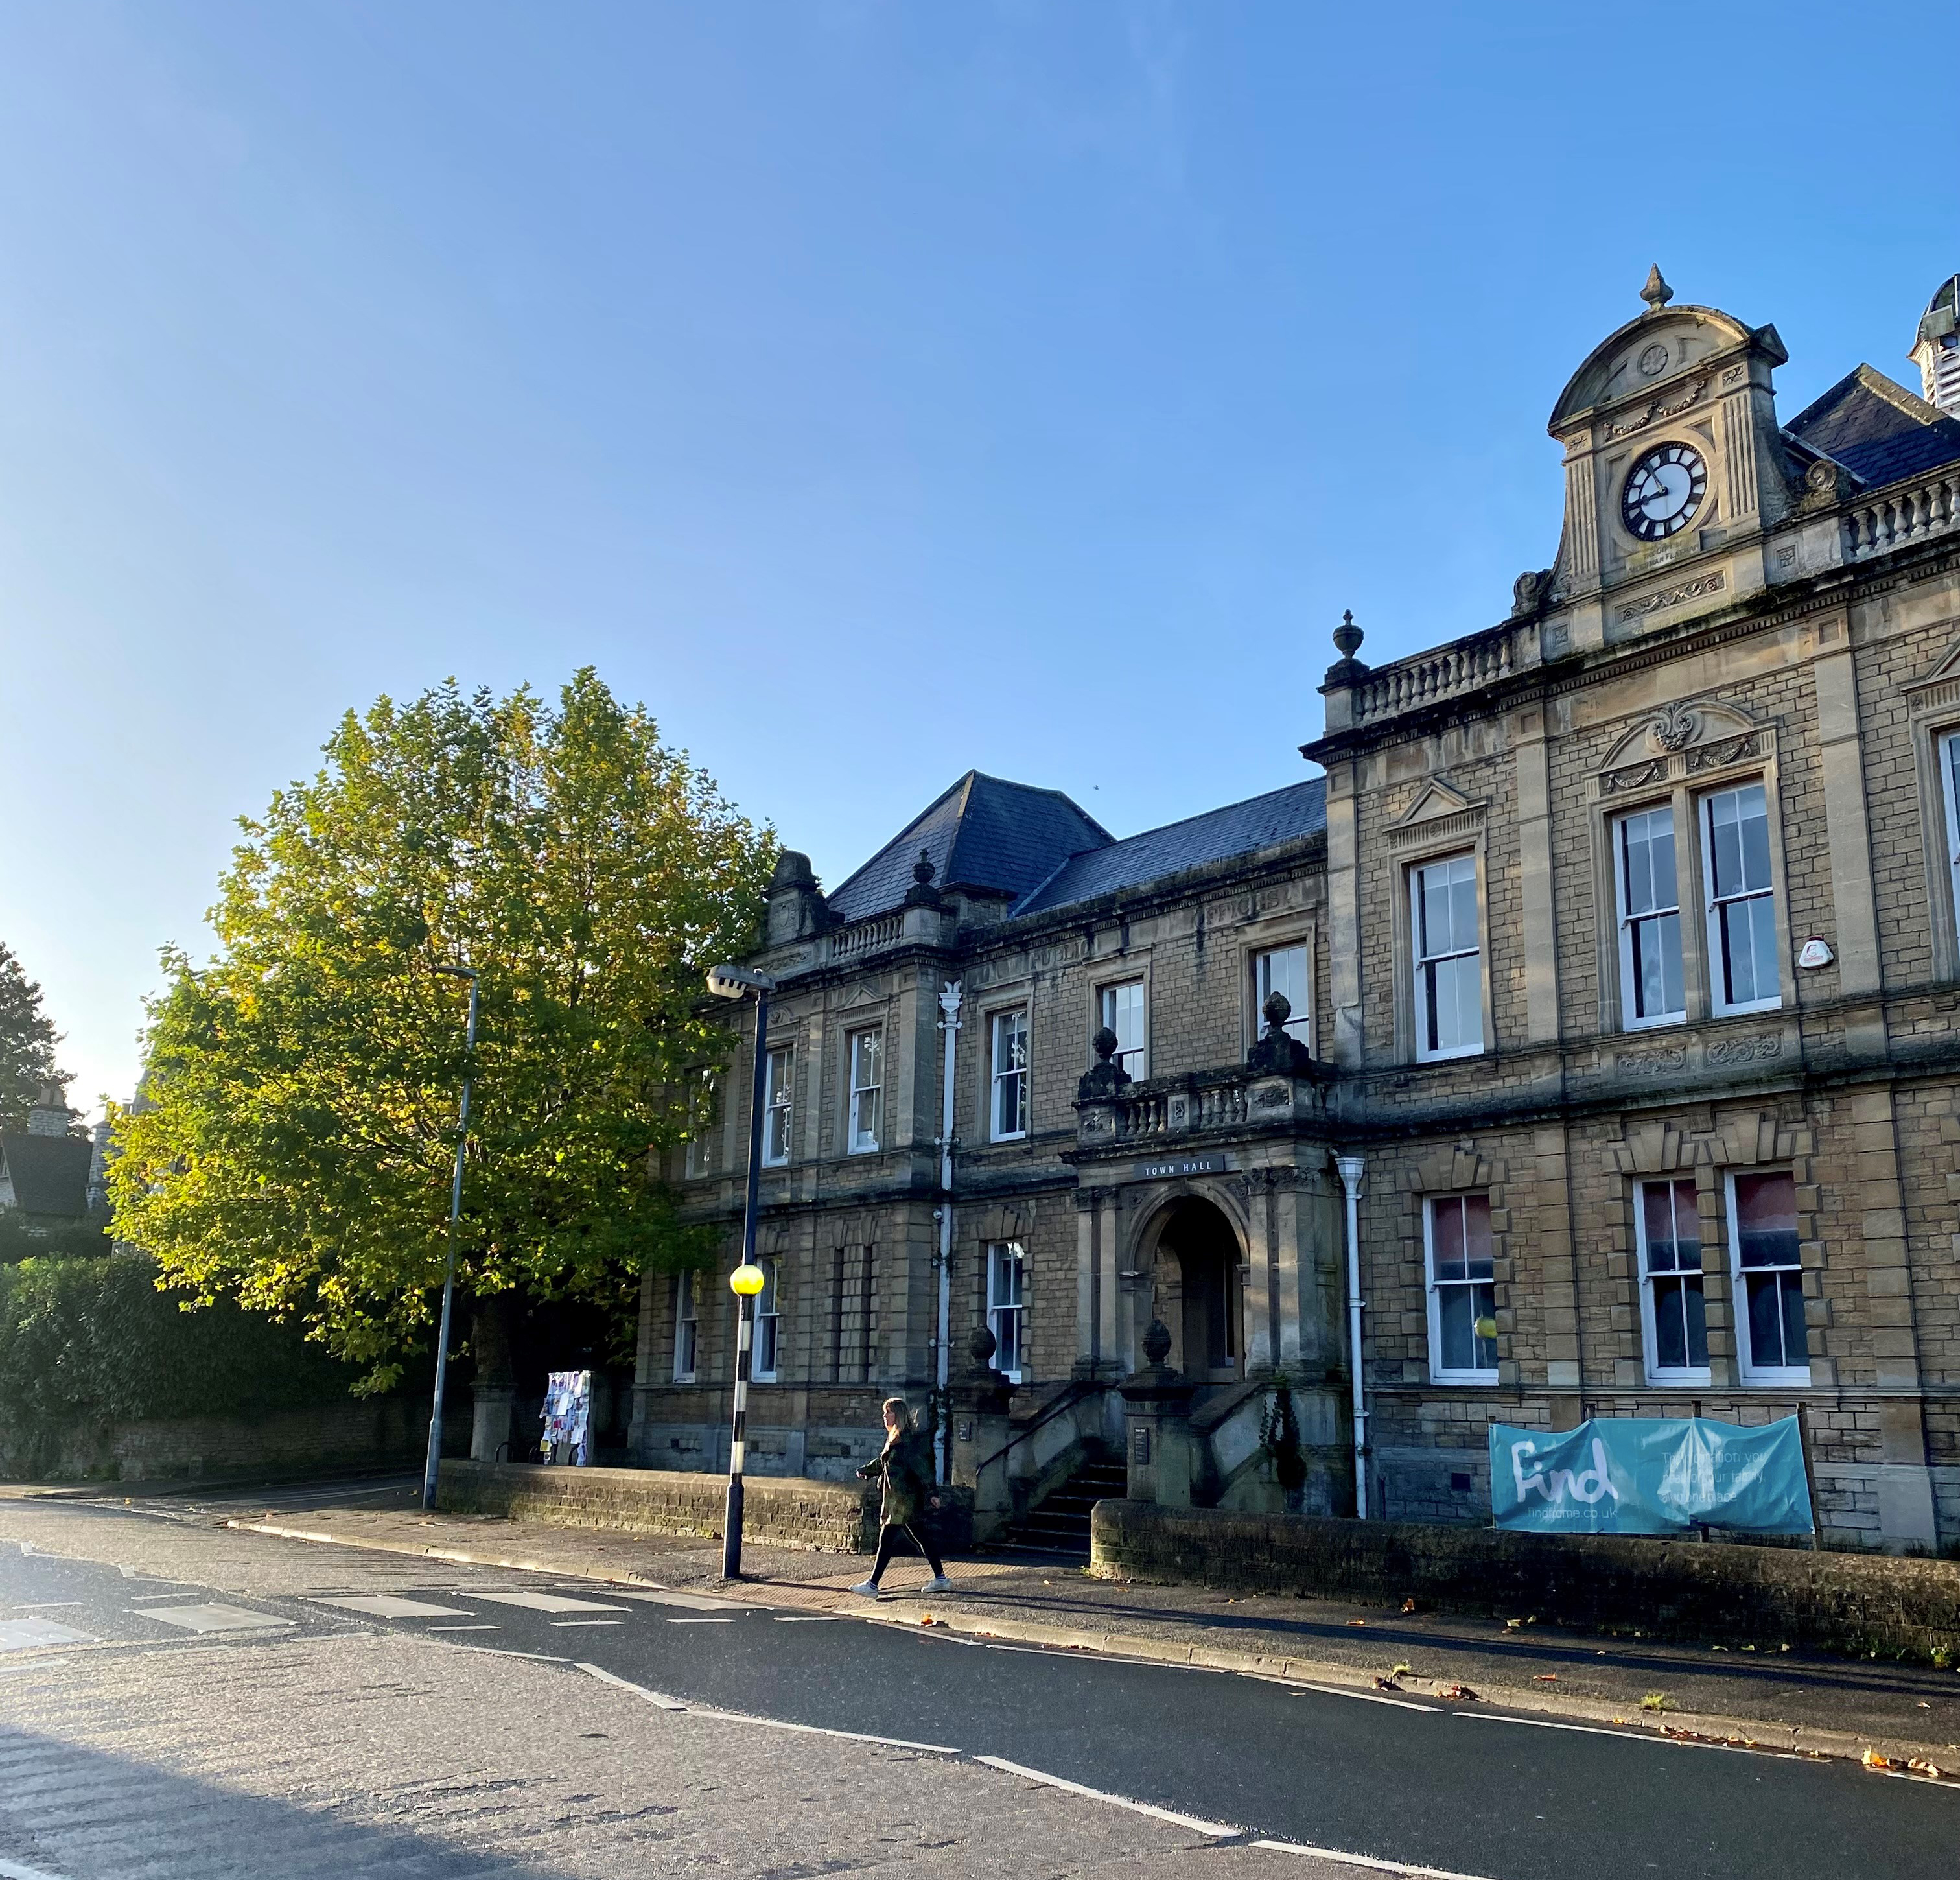
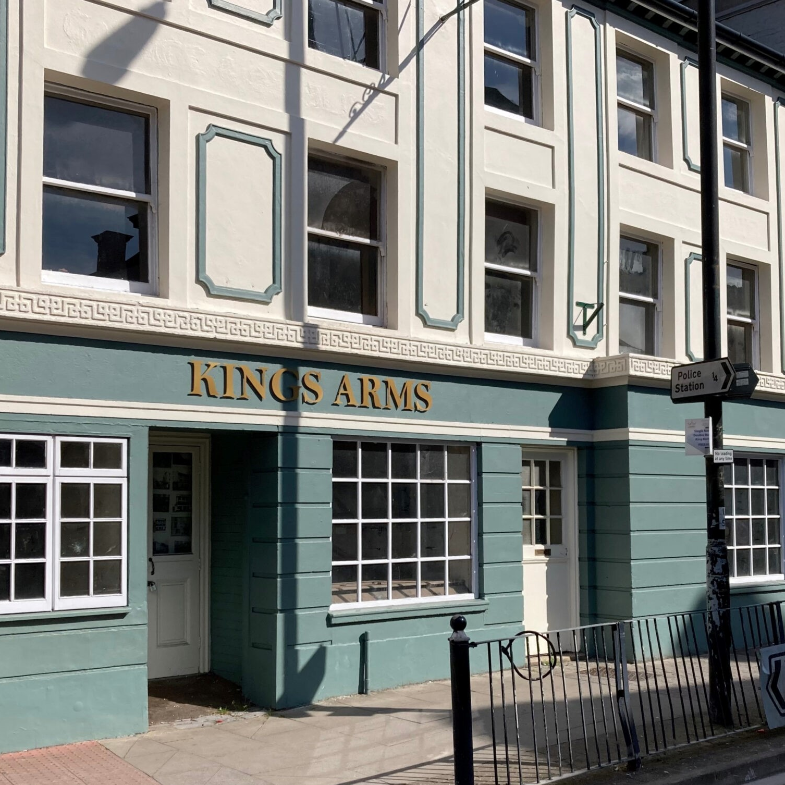
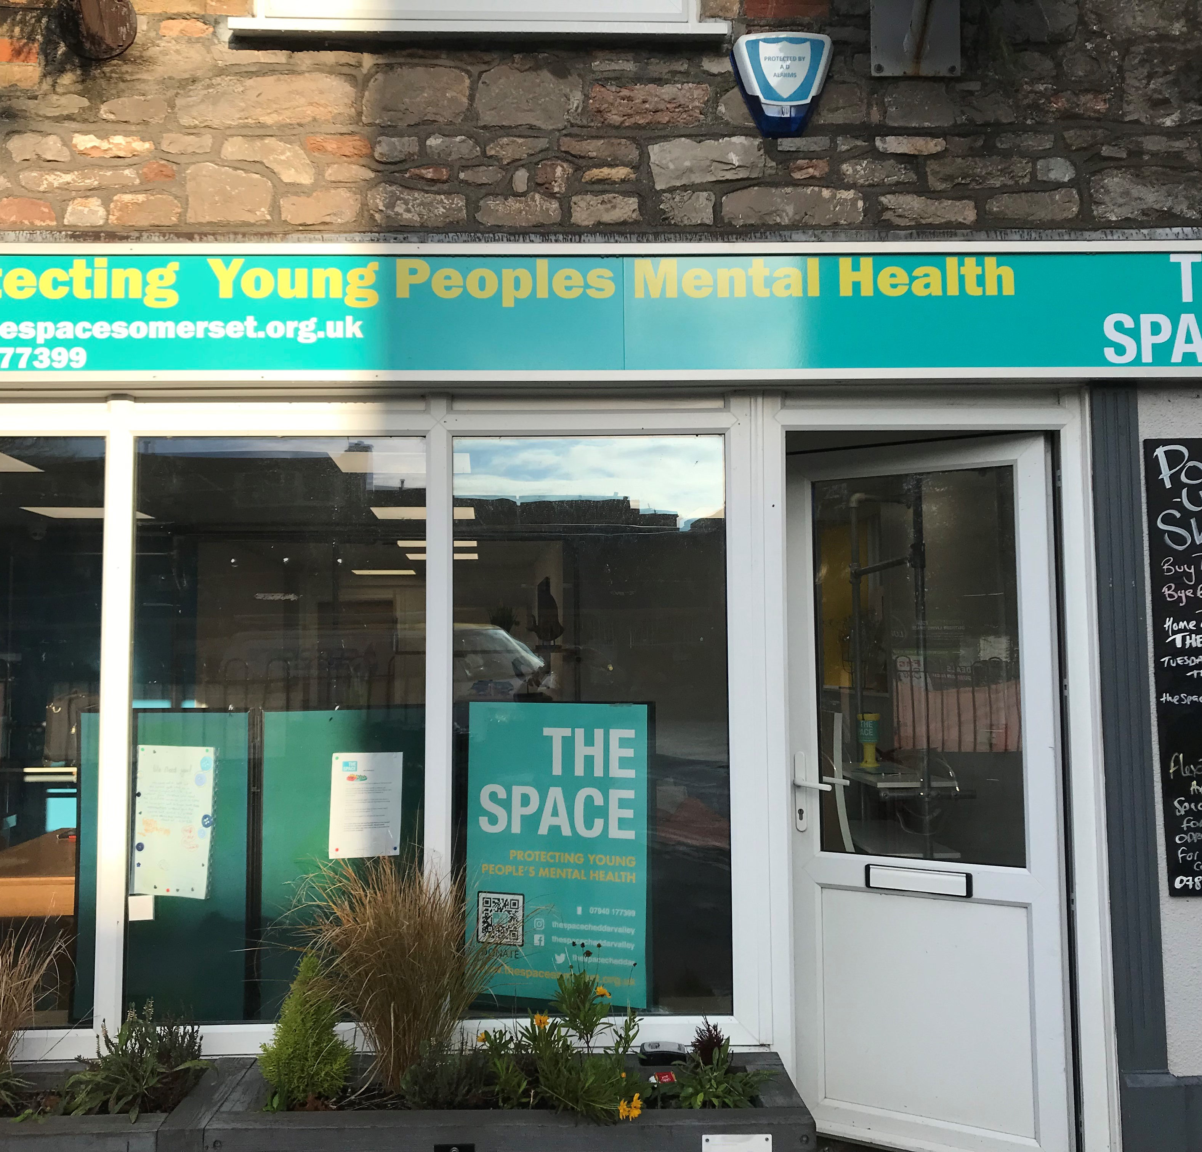
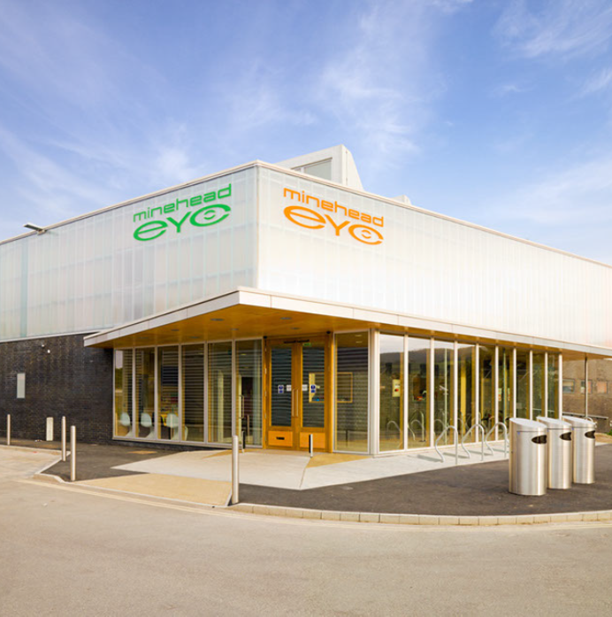
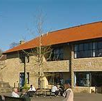
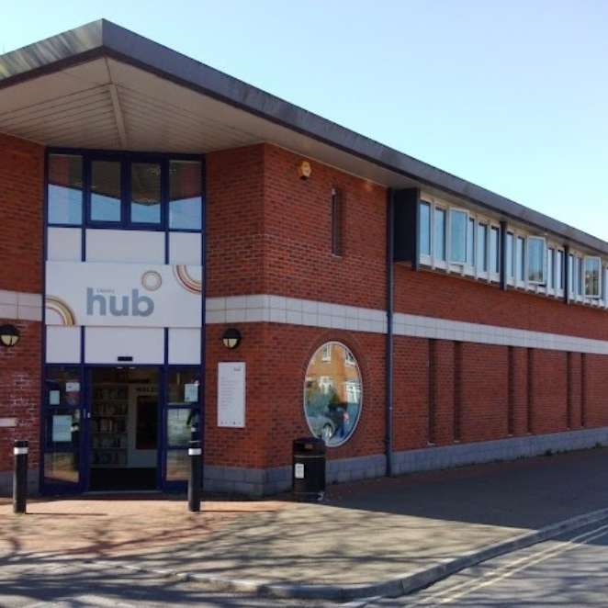


So what does Connect Somerset add?
Champion capacity to join up the public sector delivery, including schools, and connect to the voluntary, faith and community sectors, and lead local culture change
Build around schools as anchors of their communities and connect them to local resources
‌Coordinate and make most of local resources, services and hubs
‌More early help, drop-ins and support, especially where there are gaps in rural areas
Reduce barriers to working together – such as process, IT and data sharing
Bring together our databases of local resources – one place to search
‌Integrate health and care, children and adults, people and place where it makes sense
‌Foundation for more services to move to local delivery – closer to home
Hubs & Spokes
Notes:
Somerset Connect will work with many of the 100 hubs in the County. A key hub will be identified in each area for coordination.​
​
Note, early help workforce (below Family Intervention Service threshold) might include:​
​
Parent and Family Support Advisors​
Village agents​
One teams​
Neighbourhood teams​
Libraries​
Team around the school​
Mental health support teams​
Inclusion support​

Slide 16




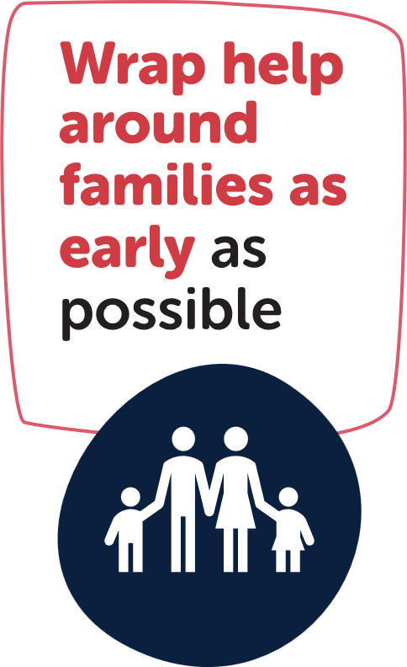

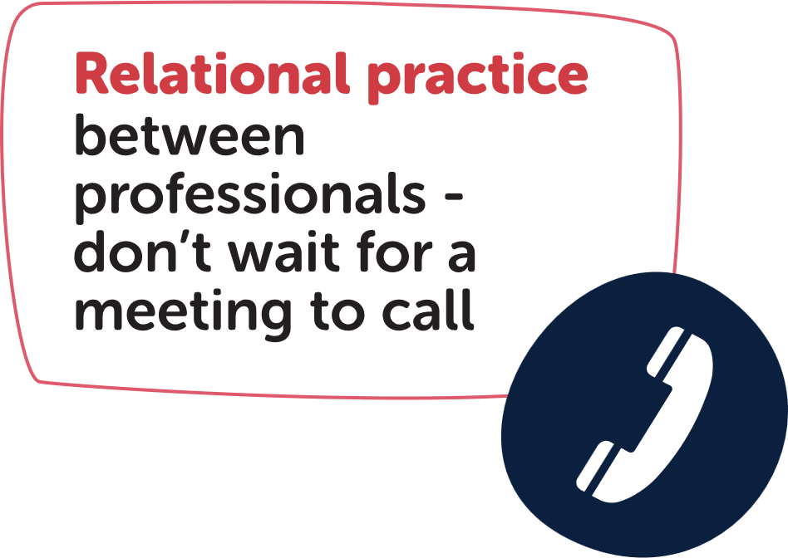
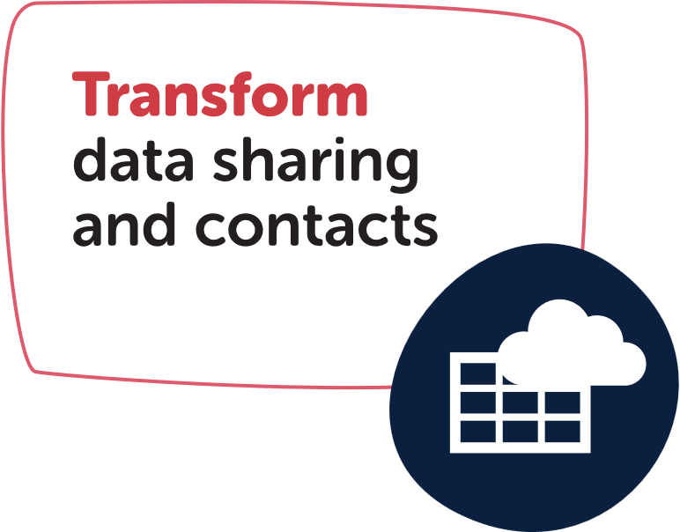
Notes:
Team around the school coordinator funding is being disaggregated to schools due to DfE budget changes.​
​
We need to put a new and more effective model in place – drawing from national practice and evidence from places such as Kent.​
​
Potential Team Around the School named professionals:​
Champion​
FIS team manager​
Inclusion team​
Relationship manager​
Mental health support team (if applicable)​
One Team Coordinator​
Later we may be able to add:​
Police PCSO​
Village and Community Agents​
Local VCFSE​
​
And Headteacher, PFSA, DSL, SENCO​

Slide 17
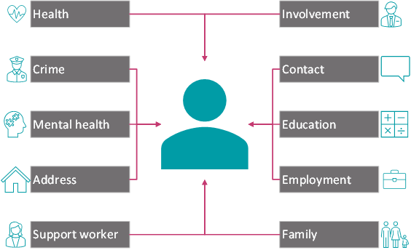
Transform Data View
Why?
Understanding the life of a child and their family has historically been a challenge
Poor or non-existent information sharing is a factor repeatedly identified as an issue in case reviews
What is Transform Data View?
Transform Data View is Somerset’s solution to joining-up fragmented case management systems
It surfaces data in one place, joining up the early help system, by showing involvements with other professionals
It is fully automated, pulling data in from multiple sources, matching the single individual’s vulnerabilities to their family members
It gives a holistic view of the family’s complexities in one place for the first time.
It identifies risk, harm and threat
Want to know more about it?
Please contact Joanne.Harris@somerset.gov.uk for further information
Somerset Council has been enabling access to Practitioners, external to the Local Authority for three years.
The positive feedback received has been encouraging, with evidence on making a significant difference to the safeguarding of children and their families.
Somerset is leading the way, nationally, with the DfE funding a project to write a guide on building the system for other Local Authorities to follow

Slide 18
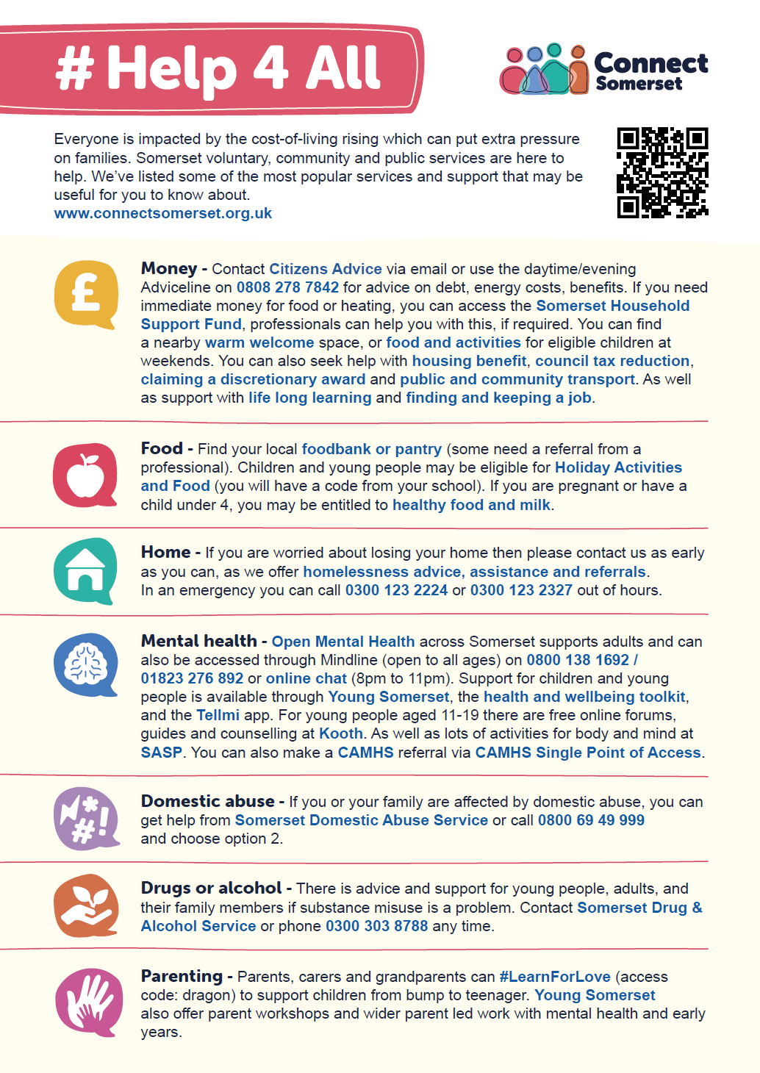


#Help4All
Easy to digest universal offer of early help that’s available to all families​
Building resilience for families​
Includes support with cost-of-living crisis, #LearnForLove parenting support, Council and partners’ advice and guidance​
All professionals have conversations with families about what’s available to help, c.f. Making Every Contact Count​
ConnectSomerset.org.uk/Help4All
Notes:
Universal offer is a way of increasing the volume of early help that is accessed, particularly by the most vulnerable families.​
​
Similar to the NHS Making Every Contact Count approach, all frontline professionals who work with families will use this simple list of what’s available to help. Importantly they will support that family to access the help, for example, bookmarking the online resource in their browser, taking them down the road to a local community group.​

Slide 19















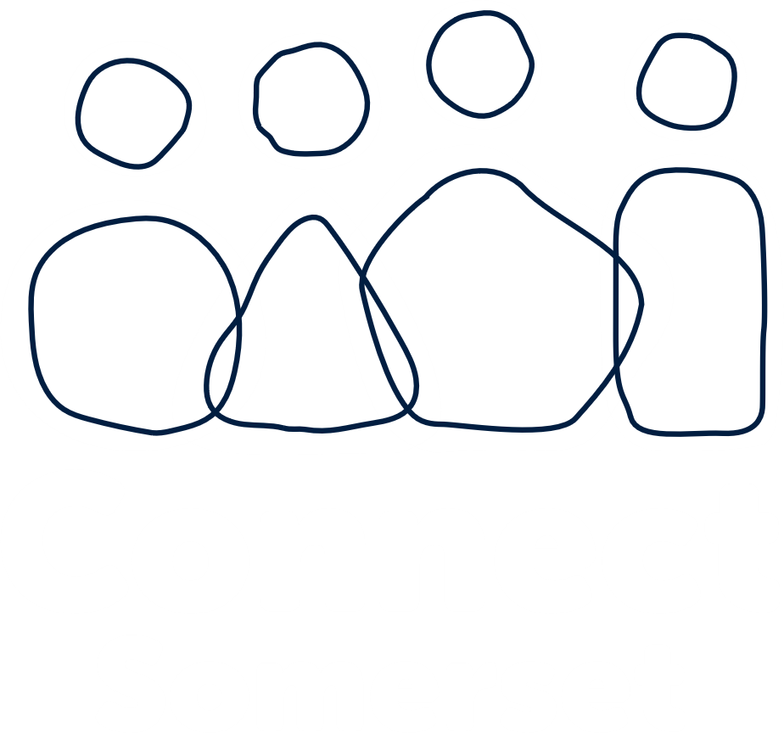
Key
Early help in the community
Anchors in the community
Universal early help offer
Shared data
Case management
Community resources
Transform
Relational practice
Trauma informed
Whole family working
Safeguarding
Personalised care
12 Champions
Investment in
communities
Identify who needs help
#Help4All
Professionals &
Community in same
Connect Somerset team
Hub
GPs
100 Hubs
Schools
Social prescribing
Drop-ins in rural areas e.g. SEND
Team around
the School
Hubs One Team Warm Welcome Community Café Local Community Network
Notes:
Blueprint infographic describing Connect Somerset​

Slide 20






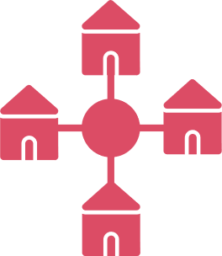


Workstreams
Team Around the School (TAS)
Universal early help offer
Automated early help
Comms to
20-30,000 professionals
Shared case management and tools
Investment in communities
Build neighbourhood teams
Workforce Development and culture
Evaluate impact

Slide 21
Timeline

Slide 22

Connect Somerset
examples for the
Smith family
Tyler – issues with attendance at school. There is a team of named professionals around the school. So the teacher phones the Village Agent who offers to provide support for parents Mandy and Matt’s alcohol abuse and low-level mental health needs. This gives Tyler a more stable home-life and helps his attendance and attainment at school.
Notes:
The Smith Family is a made-up example of a family with a set of needs, to illustrate how services can support.

Slide 23
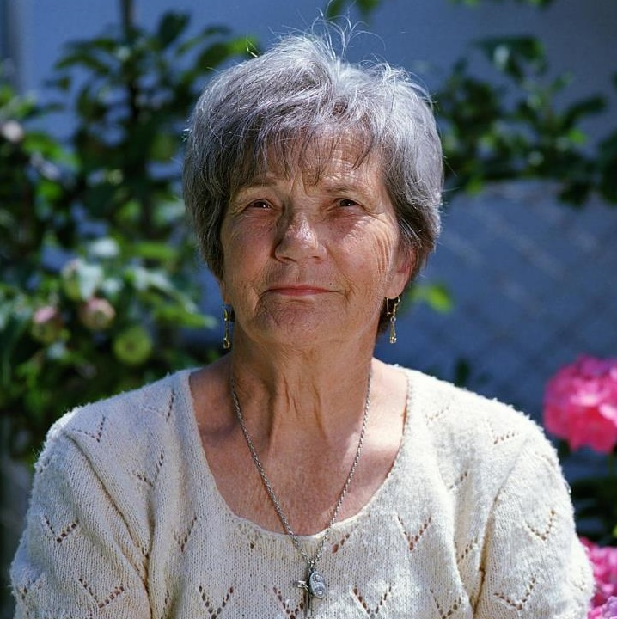
Rose – has been visiting her GP on a monthly basis. The GP refers Rose to a health coach through social prescribing. The health coach recommends a Talking Café at the hub down the road where she volunteers. At the Talking Café, Rose is able to socialise and develop a friendship with a local community group – feeling less lonely and developing her resilience.

Slide 24

Mandy and Mason – drop
in to a local hub for support with speech and language needs. These drop-ins are available across the County in rural areas. Whilst at the hub Mandy finds out about a local database of community resources and uses it to connect to a group of Mums with children with similar needs. Because Mandy is getting peer support she is better able to cope with stresses in her life.

