Slide 1
Connect Somerset is a partnership between Somerset Council, Somerset NHS, Voluntary, Community, Faith and Social Enterprises, and Schools, Colleges, Early Years settings, and more
Notes:
Connect Somerset is about everyone working together to increase early help in the community. Connect somerset is not a service but a way of working together.
We know families and residents are going through challenging times. Across state funded and community sectors, Somerset services are finding it difficult to meet demand and help those who need support. So Connect Somerset is a big partnership that includes Somerset Council, Somerset NHS, Voluntary, Community, Faith and Social Enterprises, and Schools, Colleges and Early Years settings, and more.
So together, we can develop an early help system that works well across all communities that need it.
Our big aim is to increase the help available for families and residents, and how quickly they can access that help. And we’re changing lots of small things that will add up to a new way of working across Somerset services for people.
These slides introduce some of the key ideas and practical ways that we can work together differently. Connect Somerset is for everyone, so feel free to use these slides and materials and tailor to your services, local area and residents. Thank you!
01/08/24 v23

Slide 2


Importance of communities...
“Building community power is essential... for two reasons.
First, tackling deprivation is urgent, so we need to harness and mobilise every contribution that can be made and there are resources, relationships, assets, energy and compassion to tap into in neighbourhoods.
Second, community life can reach parts that the state cannot, and provide the relationships, purpose and connection that make it more likely that life goes well.
“But this is not about the state getting out of the way. This work will only succeed where community power meets a like-minded local state. That requires an openness to shifting culture and ethos toward more relational, human centred and no-wrong-door ways of working that support people to get the help they need when they need it, rather than being told to come back when a threshold has been surpassed.
It also requires a commitment to building community wealth and power, to make a sustained impact on reducing hardship.”
Notes:
These lines are from a blog by Joseph Rowntree Foundation and New Local: www.jrf.org.uk/blog/design-out-deep-poverty-strengthen-social-safety-net ​
It’s really tricky to describe a new way of working across a whole local area, and we think this is a good start.
It’s particularly important that we find a way of working in symbiosis and on the same level – between public services and the community (i.e. “…where community power meets a like-minded local state”).

Slide 3










Living in Somerset
11% of adults identify themselves as carers
19% have a long-term health problem or disability
15% live with depression
14% of children live in low-income families
90% of families on Universal Credit cannot afford basics
9% live in a deprived neighbourhood
20% do not have access to a car
Inequality in life expectancy is 6 years for men and
5 years for woman
62% of adults are obese or overweight
Notes:
Somerset is a wonderful county, but for some it can be difficult living here. Maybe you’re an older resident who is lonely, of a family struggling with the price of food or rent, or suffering from poor mental health or a disability that prevents you from working.
The cost-of-living crisis has left some residents more vulnerable to external pressures.
We are still seeing the impact of Covid-19 on development of young people – more children in care with higher levels of need such as mental health issues for girls and high levels of violence for boys.
What does it feel like growing up in Somerset? What reflections do you have from services or personal life?

Slide 4
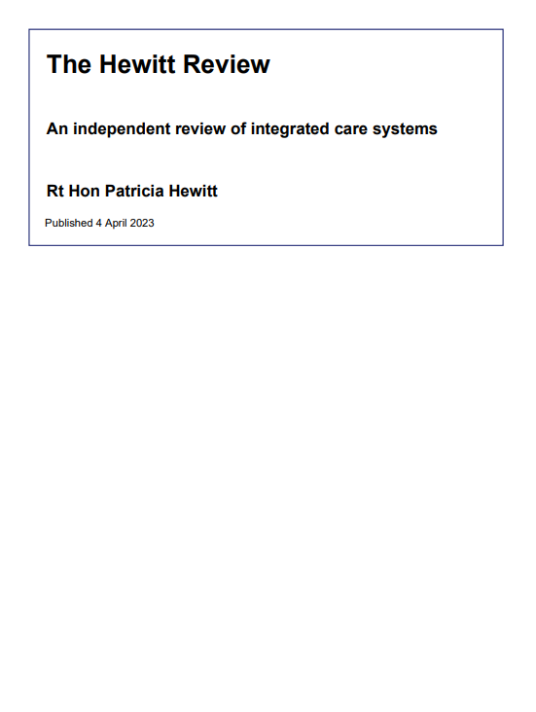

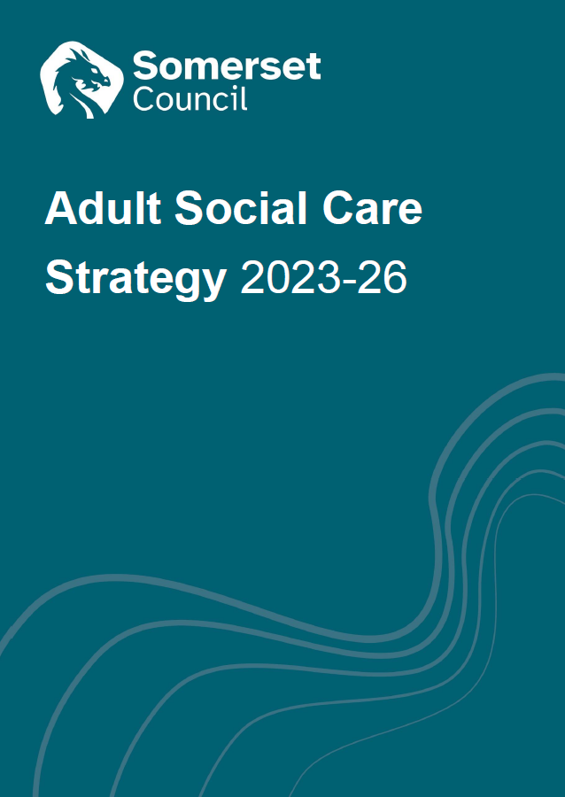
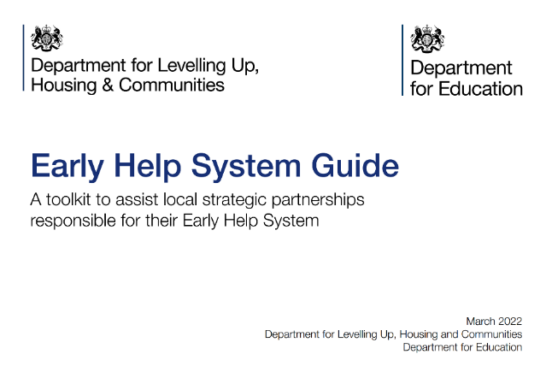
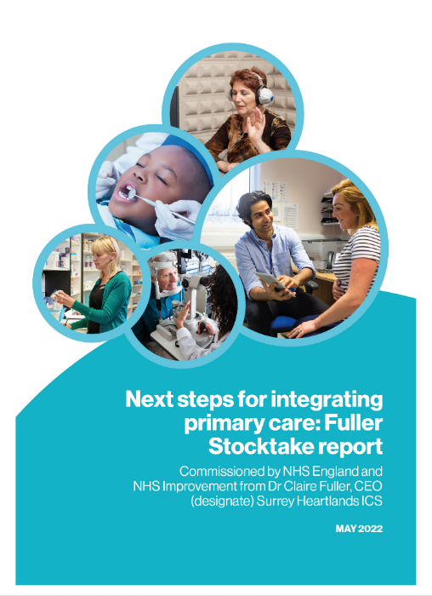



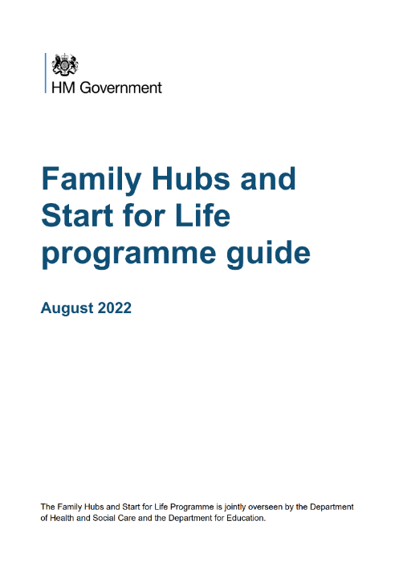
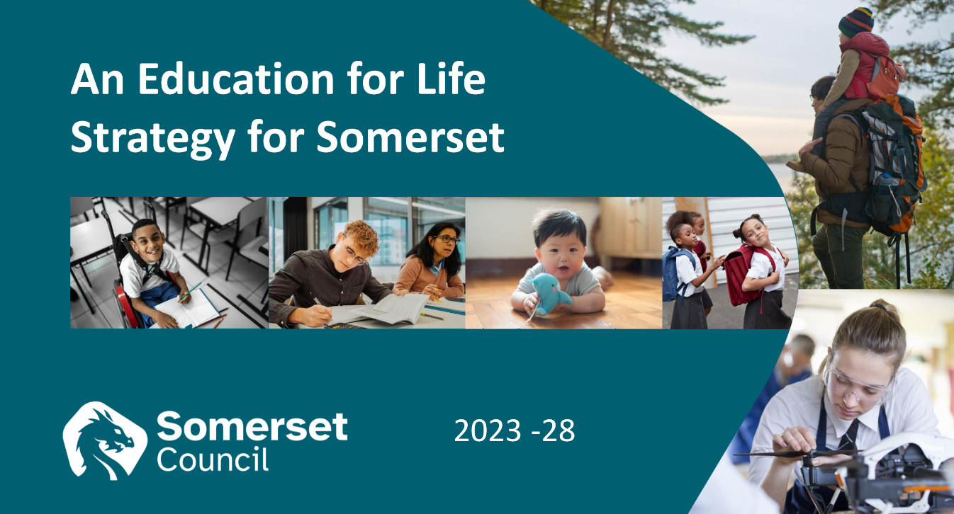

Context
Notes:
We’re building on key policies and strategies from DH, DfE, MHCLG and our own Integrated Care System and Somerset Board.​
Council plan – priorities include ‘A Healthy and Caring Somerset’, ‘A Flourishing and Resilient Somerset’, ‘A Fairer ambitious Somerset’​
ICS Fit for My Future vision – to integrate health and care services with an all-age model of support​
Children and Young People’s Plan – six priorities for improving children’s lives, told to us by 6000 children and young people
Education for Life strategy – ambitious strategy to improve the Somerset Education system and children’s services across the partnership​
DHSC Fuller stocktake – primary care and communities should integrate as leads to better outcomes and reduced inequality​
MHCLG Early Help System Guide – integrate at the community level to improve families’ lives. Endorsed by DfE.​
DfE Family Hubs – local hubs and service offer with partners. Themes of Access, Connected and Relationships.​

Slide 5
Demand
Demand
Service
Notes:
Important when we’re discussing an early help model that we have a clear understanding of ‘demand management’.​
This is a representation of an ideal service model where demand for support equals the service volume​
But we all know it’s not quite like that, especially given the c. 50% reduction in real-terms spend since 2010​

Slide 6
Challenge
Demand
Service
Notes:
So the service shrinks, demand grows, and we put up thresholds and barriers to success. This is a sub-conscious organisational response.​
Two things:​
There isn’t a balance – eventually demand will overwhelm the service. This statutory minimum service model will break if we don’t put enough money into it.​
If you are one of the people waiting for a service or being pushed away – it feels very unkind. Which mirrors the deuteriation in relationships between the public and public sector.​
Alternative is to find a way of helping more people, earlier. i.e. increasing demand so we can meet that demand in a more cost-effective way, and therefore reduce demand and costs for expensive acute services.​

Slide 7
The early help system
Parent,
Family
Support
Advisors​
Early Help is the total support that improves a family or resident’s resilience and outcomes or reduces the chance of a problem getting worse
GP & Dentist
Sports & Leisure
Maternity services
Arts & Culture
Village Agent
Social Care & FIS
Library
Youth Services
Housing
A&E
Health Visitor
Community
School & Post-16 Education
Probation
SWAST Ambulance
Mental Health
Local Business
Voluntary, Faith and Community groups
CAFCASS
Alternative Provision
Youth Justice
Community Nursing
Nursery
Police
Benefits
Special Educational Needs
Family & Friends
Digital Support
Drug & Alcohol Misuse
Residential & Nursing Care
Jobcentre Plus
School Nurse
Place & Environment
PCN Neighbour-hood team
Prison
Speech & Language
Home care
Pharmacy
Fire & Rescue
Key:
Community
Universal
Acute & Targeted
One Team​
Notes:
This is how the early help system works. Lots of different agencies and organisations. ​
​
Most important part is in orange around the family and resident, it’s what we all experience that helps us to be resilient when things go a little wrong in our lives.​
​
Orange – Community​
Blue – Universal services​
Pink – Acute and targeted services which also provide early help​
Early Help is a big and complicated system, with maybe 20,000 to 30,000 people working in Somerset.​
​
Not going to tell everyone to adopt a new target operating model, as there is little direct control. It’s about how we connect professionals and communities, why we got into people services in the first place, how we can improve families and residents’ lives better by working together.​

Slide 8

Why talk about systems?
Dr Ackoff’s example of a car
Let’s build the best car in the world. Take the best brakes, best controls, best tyres, best gearbox, etc and put it together.
Is this the best car? Does it even work?
How do we manage services vs the system?
It can be counter-intuitive, but…
The system makes as much of
a difference as individual services
Notes:
The quality of each service is important, but the system is equally important. This is the focus of the transformation programme, but it’s often a cultural shift to try to conceptualise and then redesign the children and family system.
Example is from Dr Russell Ackoff: Suppose you’re building the best car in the world. You would go about it by first bringing each of all the car models in the world to one place. You would then hire the best vehicle engineers and mechanics in the world and ask them to determine which of the cars has the best engine. If the engineers say that the Rolls-Royce has the best engine, you would pick the Rolls-Royce engine for your car. Similarly, you would ask your engineers to find out which of the cars has the best exhaust system and pick that for your future car. Using this method, you and your team would go through the necessary parts for building a car and in the end have a list of the best parts available in the world. You would then give the list to your engineers and mechanics and ask them to assemble the car. What do you think you will get?
The answer is obvious: you don’t even get a car! The parts won’t simply fit together. An engine from a Rolls-Royce won’t work well with an exhaust system from a Mercedes.
The performance of the car is dependant on the interaction of its parts, not on the performance of the parts taken separately.
In the public sector, we focus a lot on the performance of each service (think KPIs, HR systems, procurement, scrutiny), but we don’t focus as much on the performance of a system. So if we want to be more efficient, don’t keep looking for small transactional savings from services, look at the efficiency of the whole system.
Demming estimated that 94% of performance is down to, or can best be improved by, the system. i.e. the performance of a system (such as early help) is how the parts fit and interact with each other, so we have to do the service design in tandem with the system design. [Controversial note: to optimise a system, you will need to de-optimise the parts.]

Slide 9
Integration
Place
People
Children’s
Adults
Health
Care
Notes:
Outcomes for residents are often inter-related, but we tend to create divisions in the public sector. E.g. we have different pathways for children and adults, the same need might be treated differently by health or social care. If we think holistically, early help is big inter-woven system.
So Connect Somerset needs to embrace this complexity and pull things together across:
​
Health and Care system​
Children and Adults services​
And People and Place (joining up People Services with Local Community Networks and what happens in local communities, parishes, town councils​)

Slide 10
Key messages
1
‌Help more residents and help them earlier
Support schools and other services to be at centre of their community and draw on community resources
Enable residents and their families to be resilient and connected to their community
‌Develop neighbourhood working, integrate services and support, closer to home
Improve residents’ lives, reduce inequality and reduce demand for expensive acute services
2
3
4
5
Notes:
We’re building from lots of local and national learning. Here are the key messages we’re using to guide Connect Somerset.​
​
(Note alignment to themes from DfE family hubs: Access, Connect, Relationships)​

Slide 11
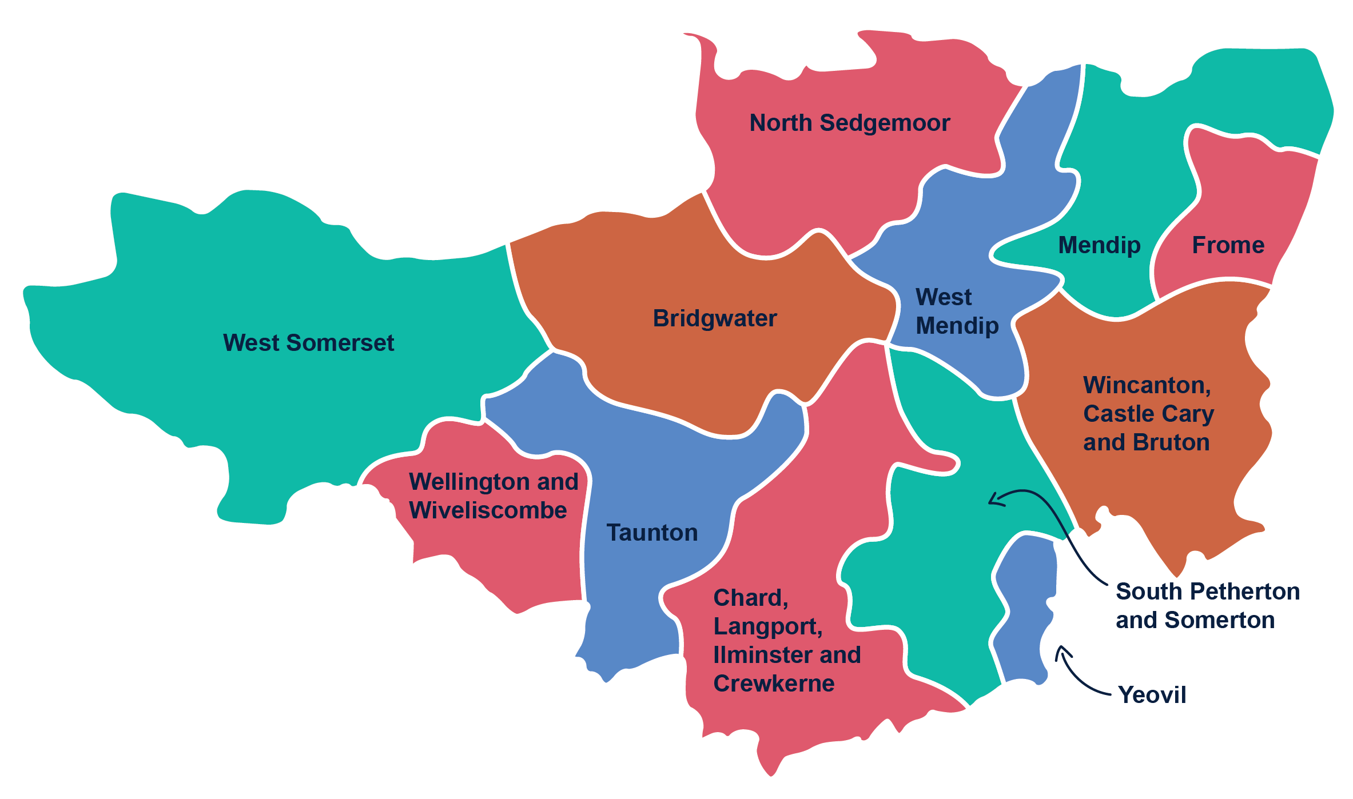
Neighbourhoods
Coterminous with Adult Services and Health neighbourhoods
Working very closely with Local Community Networks and School Clusters
Aligned with Primary Care Networks
Best alignment with system to maximise integration and wrap around families and residents
Notes:
The neighbourhood geography enables us to align as much as possible with Children’s and Adult Services, NHS primary care networks, the Integrated Care Board and Somerset Foundation Trust.
Services will increasingly operate in neighbourhoods, because:
this enables local professionals to get to know local resources and community assets that can support residents.
It also helps professionals to get to know each other and work more closely together (improving relational practice).
This means we can confidently step outside our comfort zones a bit to wrap around families and residents, and
we reduce referrals which are bad for residents’ experience and often expensive.
We will continue to work very closely with Local Community Networks and School Clusters​.
​​

Slide 12
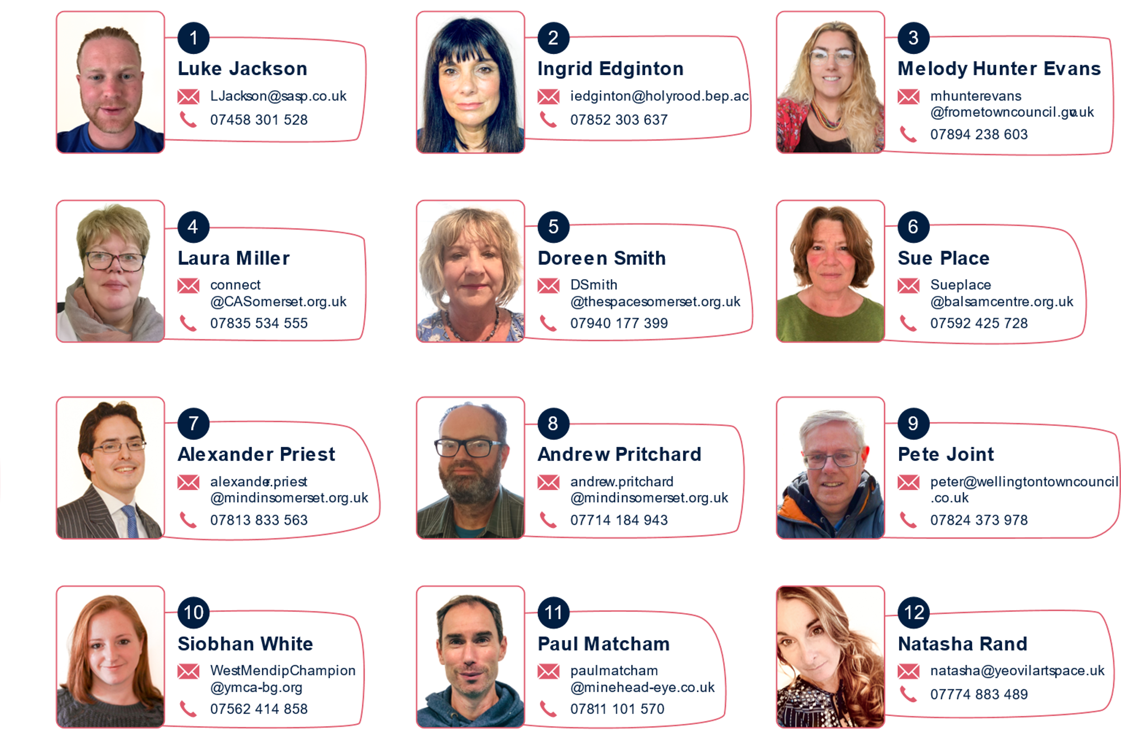
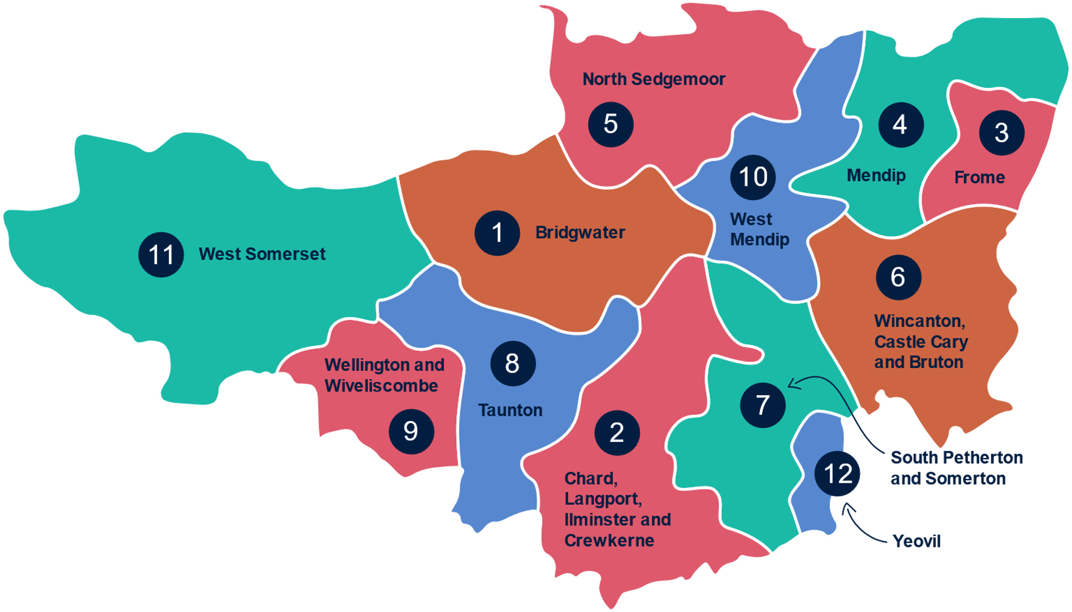
Find your Champion

Slide 13
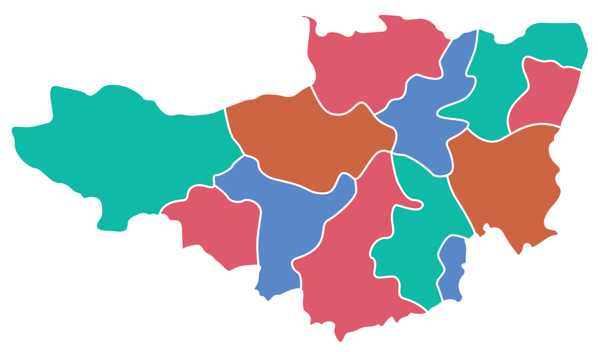
North Sedgemoor – Working closely with the Wessex Learning Trust to develop the Team Around the School model and to utilise the community hubs and spokes in the neighbourhood to support local key priorities, enabling statutory and community services to come together to work as one.
West Mendip – Working with Crispin and The Blue School to identify gaps in parenting offer and establish new provision. Creating links between early years, youth and adult provision across statutory, council, school, health and Voluntary, Community, Faith and Social Enterprise to promote a whole-family approach.
West Somerset – Continuing the partnership with Living Better Primary Care Network, CCS Village Agents and key education and health services to provide a health and well-being hub.
Bridgwater – Working with the Bridgwater Bay Primary Care Network and Social Care to connect Health Coaches, community provisions and local community spaces to enhance and compliment the provision on offer to residents.
Mendip – Linking Parent Family Support Advisers and the Family Intervention Service to the Voluntary, Community, Faith and Social Enterprise, enabling the delivery of a cohesive support package to parents and families.
Connect Somerset Champions are working on lots of priorities to support their local neighbourhoods.
Here are a few examples…
Frome – Leading the Children & Young People Mental Health Forum meetings to support networking and partnership working.
Wincanton, Castle Cary and Bruton – Working on alternative provision for Children and Young People not attending school due to Social Emotional Mental Health needs.
Wellington and Wiveliscombe – Leading the development of the Kings Arms Early Intervention Hub within the community including promoting engagement from statutory services to extending their offer into the heart of the community.
Taunton – Supporting the Professional Practitioner Pilot with the Family Intervention Services in Pyrland and Monkton Wood Academy.
Yeovil – Supporting the County Lines Creative Project in partnership with Yeovil College and Bucklers Mead Academy
Chard, Langport, Ilminster and Crewkerne – Strategically enabling Community Leaders to focus on Early Years and the Cradle to Career initiative.
South Petherton and Somerton – Enabling health and social care partners to use the Martock Information Centre and other hubs, schools and community venues to meet people within their community, reducing travel anxiety and bringing more services closer to families.
Notes:
Here are small examples of some of the work in development across Somerset, led by local Connect Somerset Champions.

Slide 14
Fantastic local hubs and resources
100 Warm Welcome hubs
273 Schools and Colleges
Community Hubs, Talking Cafés, etc
18 Local Community Networks
13 Primary Care Networks and Adult Social Care Neighbourhoods
2760 registered charities with 10,300 volunteers
Parent, Family Support Advisers,
Village agents, Community Agents, One Teams
Health Connections, Social Prescribing
Link Workers, Health Coaches
Public services in schools and early years settings, GP surgeries, libraries, social care, hospitals and community settings, health visiting, police, etc
Notes:
Somerset is lucky, there are so many fantastic local resources across all our sectors. We want to work with everyone we can to help improve families’ and residents’ outcomes.​
​
Note that in the past, we’d have done a new model, built new hubs. Now we want to use buildings and resources that residents are already accessing – this is more collaborative and accessible (reducing the impact of inequality).​

Slide 15
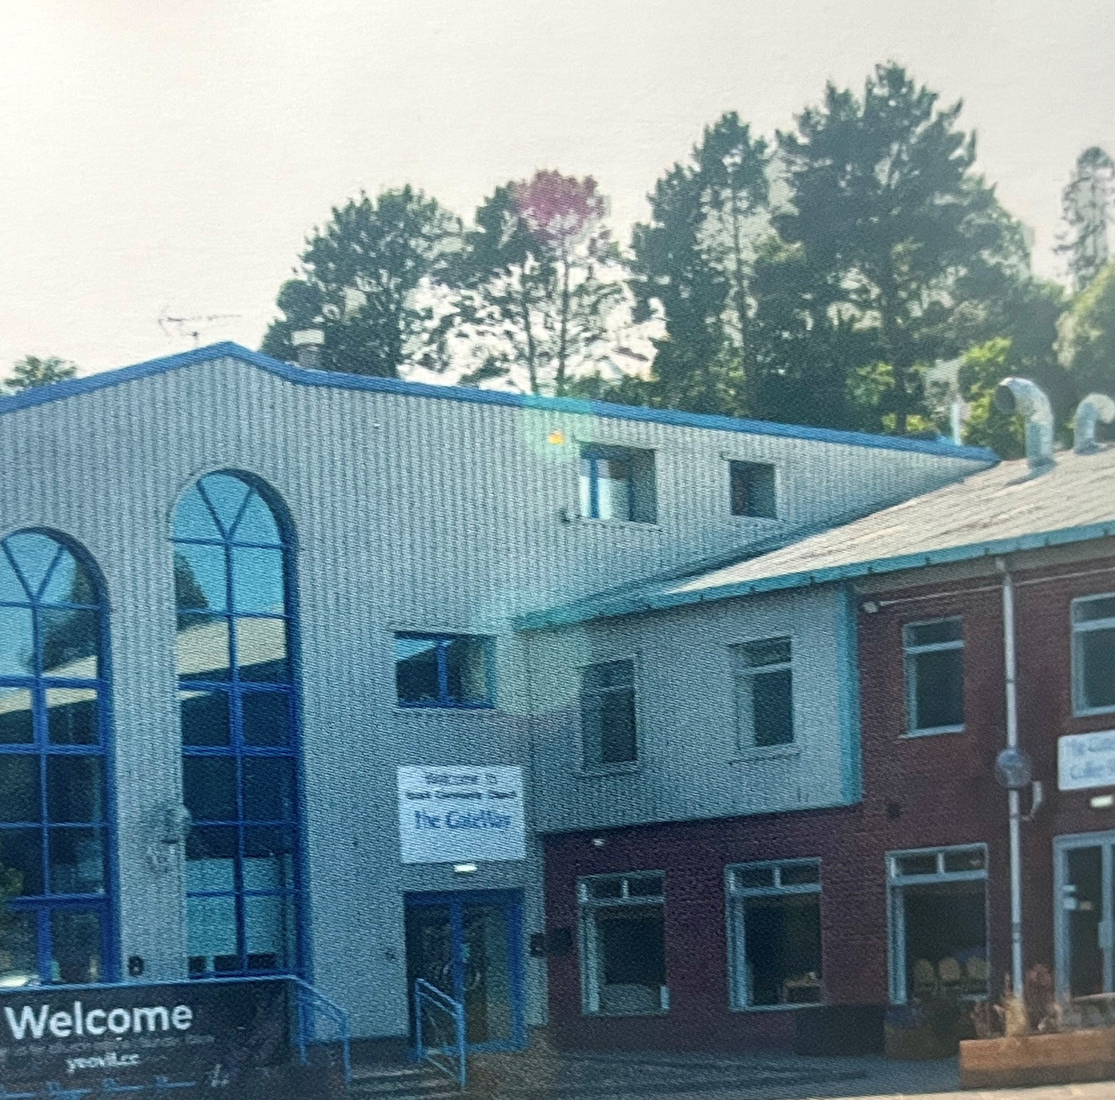
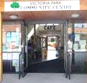
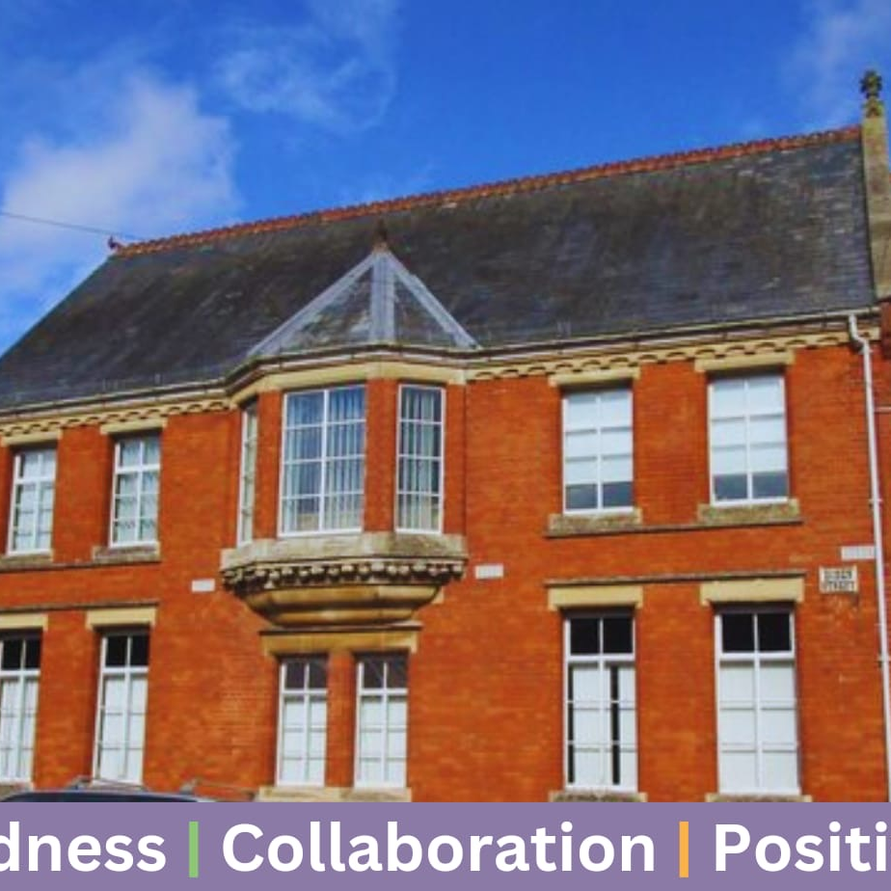
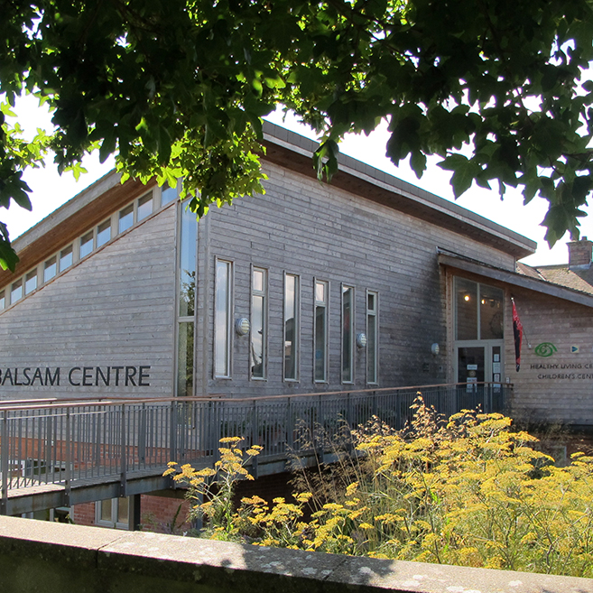
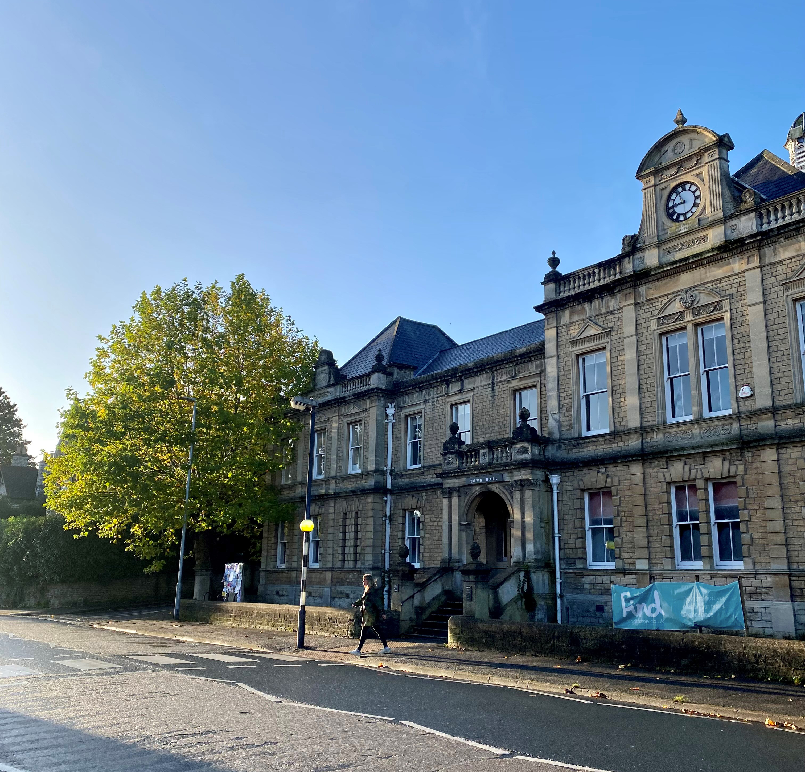
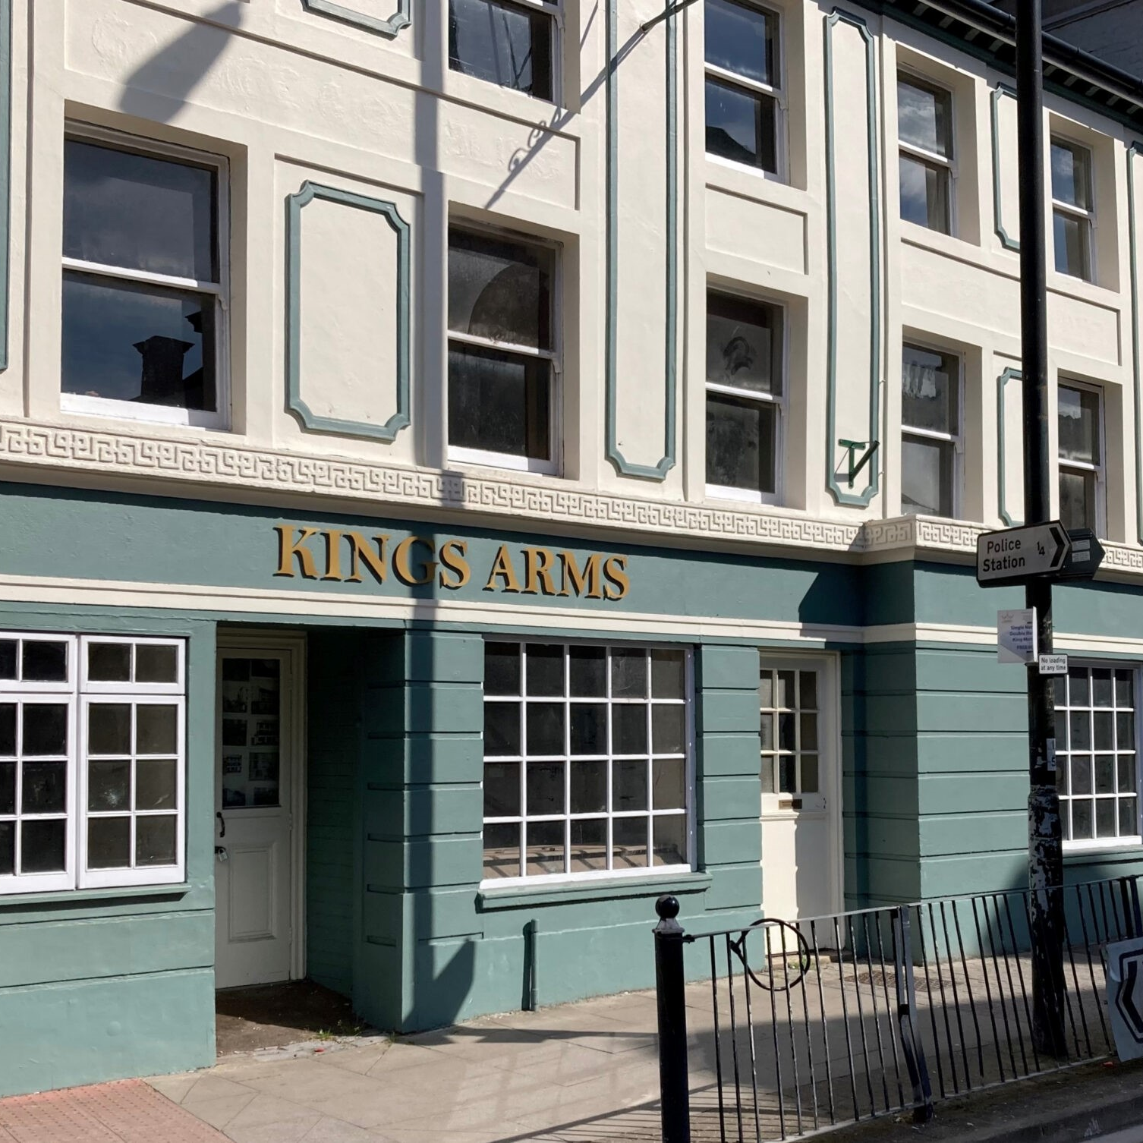
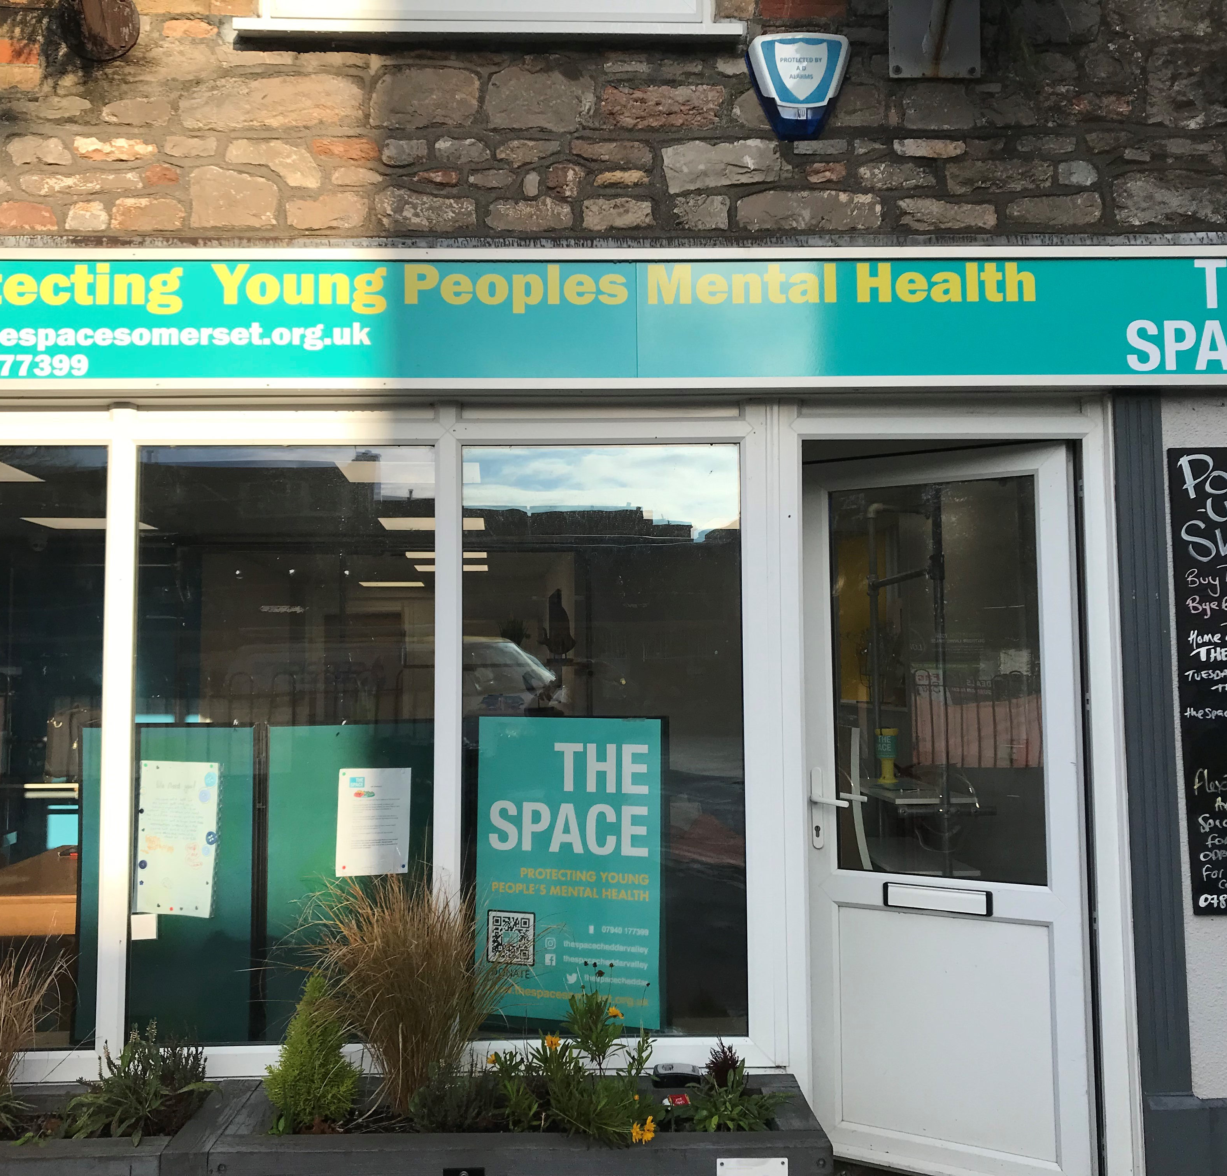
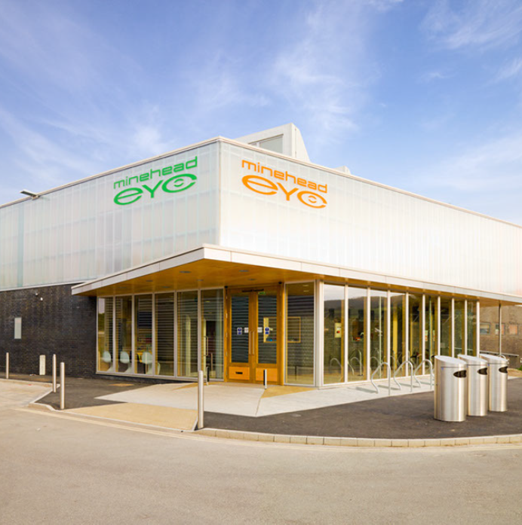
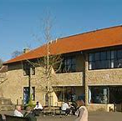
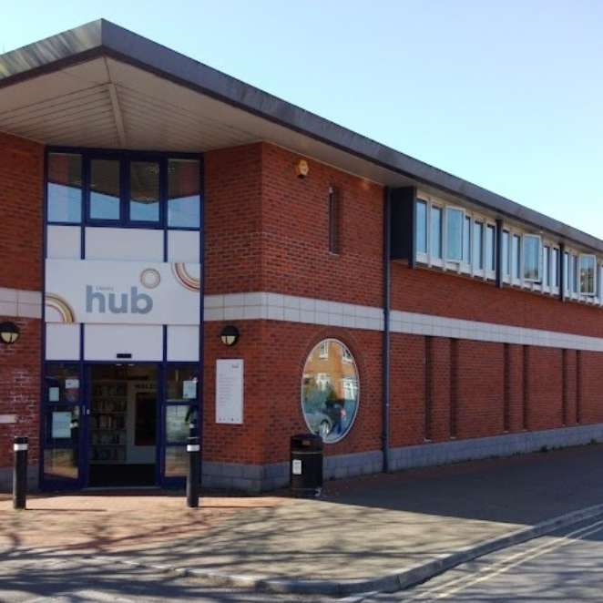


So what does Connect Somerset add?
Champion capacity to join up the public sector delivery, including schools, and connect to the voluntary, faith and community sectors, and lead local culture change
Build around schools as anchors of their communities and connect them to local resources
‌Coordinate and make most of local resources, services and hubs
‌More early help, drop-ins and support, especially where there are gaps in rural areas
Reduce barriers to working together – such as process, IT and data sharing
Bring together our databases of local resources – one place to search
‌Integrate health and care, children and adults, people and place where it makes sense
‌Foundation for more services to move to local delivery – closer to home
Hubs & Spokes
Notes:
Connect Somerset isn’t a specific service, but there’s lots we add to help the system operate better, both at a local level and county-wide.
Most of the time, we’re trying to get out of the way of professionals so they can work well together, for example removing IT or geographic barriers or processes that stop you.
Or enabling helpful ways of working, such as by sharing data, identifying local hubs for delivery, connecting to local resources.
Note that whilst we have selected 12 places that local residents identify as community hubs, we’re keen to expand this out to 100 hubs across the county, so services can be accessed closer to home. Particularly in rural areas.

Slide 16
















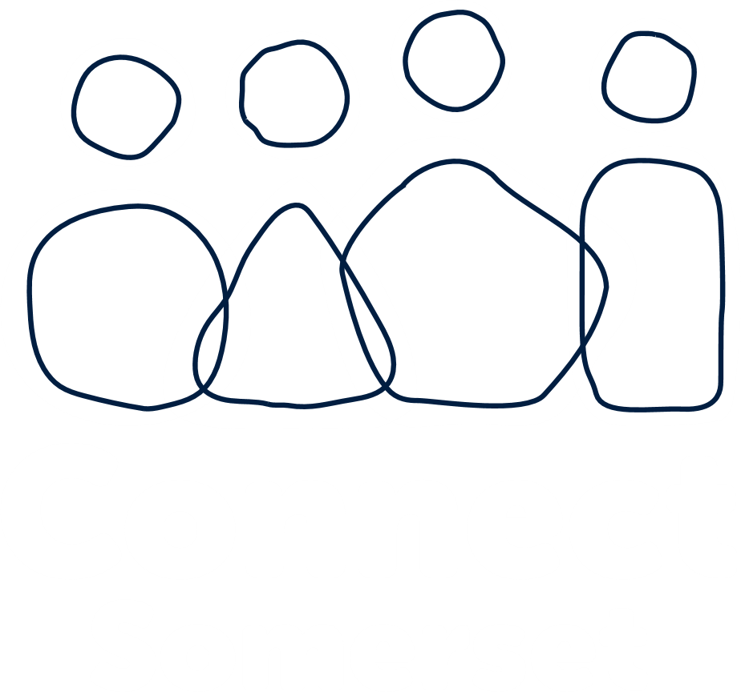
Key
Early help in the community
Anchors in the community
Relationship based
Trauma aware
Whole family working
Safeguarding
Personalised support
Key worker
Universal early help offer
Shared data
Case management
Community resources
Transform
12 Champions
Investment in
communities
Identify who needs help
#Help4All
Professionals &
Community in same
Connect Somerset team
Hub
GPs
100 Hubs
Schools
Social prescribing
Drop-ins in rural areas e.g. SEND
Team around
the School
Hubs One Team Warm Welcome Community Café Local Community Network
Notes:
This is our infographic describing some of the things in Connect Somerset​.
As we said at the beginning of the slides, it’s really tricky to show how all the changes interact with each other and lead to a more efficient system of services and support across Somerset. We’re hoping a diagram helps!
Important to point out that we want all professionals and community groups to feel like they are in the Connect Somerset team together. If we emphasise similarities and connections, we are more likely to work well together.

Slide 17
What can professionals do?
We focus on strengthening relationships between professionals and with residents. People, processes and systems are caring.
We listen to families and residents – to understand what matters for them, to build on what is already working well and to design services, based on what we learn from individuals and their communities.
We spend less time on diagnosis, assessments and referrals – and more time helping when people need it, stepping outside of our comfort zone.
We use relationship based and trauma aware practice, personalised support (personalised care) and whole family working. Everyone can be a key worker for a family or resident.
Support and services will increasingly be based in neighbourhoods and community hubs – we work together across geographic and professional boundaries and with communities, recognising the challenges of rurality.
We recognise that communities have different strengths and needs and work flexibly to support both individuals and communities.
We share data and intelligence so we can offer more help to those most in need, and children don’t slip through the net.
As a system by supporting earlier, the need for acute services will reduce over time, offering more investment early in communities and reducing inequalities across Somerset.
Notes:
We can all do something to support Connect Somerset – whether you are a professional, community volunteer, commissioner or manager. All 20,000 to 30,000 of us working in early help…

Slide 18
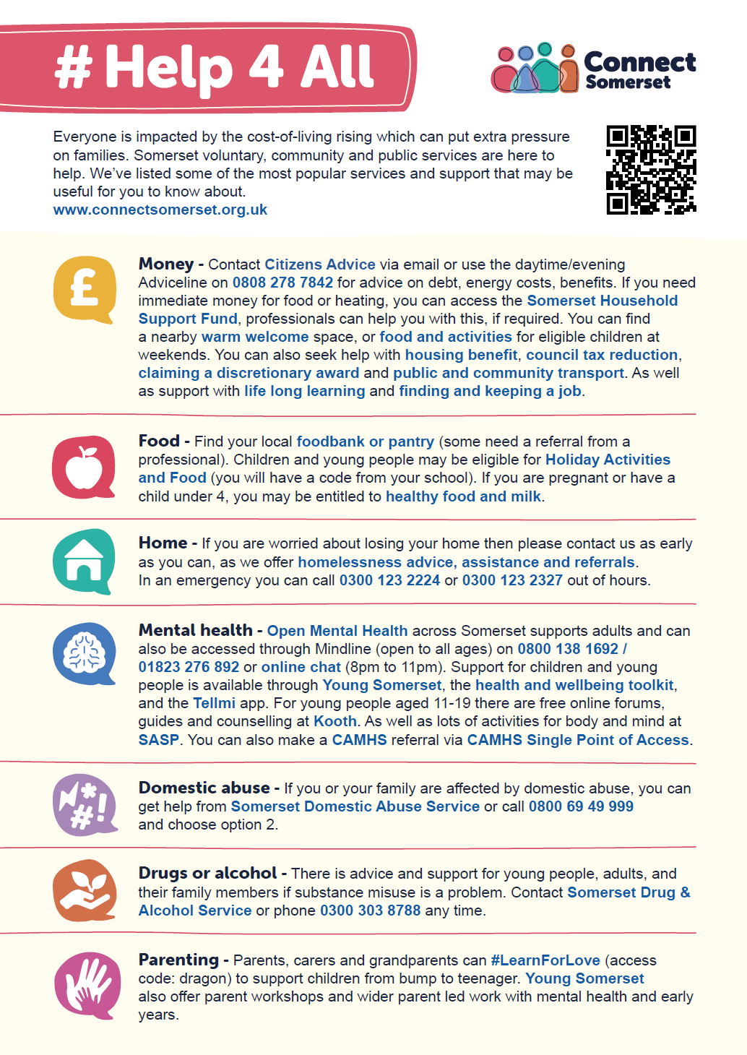

#Help4All
Easy to digest universal offer of early help that’s available to all residents​
Building resilience for families​ and residents
Includes support with cost-of-living crisis, #LearnForLove parenting support, Council and partners’ advice and guidance​
All professionals have conversations with families about what’s available to help, and help them to access that support
www.ConnectSomerset.org.uk/Help4All
Notes:
#Help4All is our universal offer of support to families and residents. We’ve made it easy to access and navigate, and there’s lots here for those who need a bit of extra support, e.g.
Money
Food
Home
Mental health
Domestic abuse
Drugs or alcohol
Parenting
But if we just sign-post residents, then some will access and some won’t, and that widens inequality. What’s important is that everyone is able to access help, so we have two requests of all professionals:
Where a family or residents could benefit from a little extra help, please have that conversation with them
Introduce them to what’s available, using #Help4All
Hand-hold or walk with them until they are accessing that help (e.g. help them to create an account on Kooth, or take them down the road to the local Talking Café)
Then we can address inequality, increase take up of early help, build resilience and reduce more acute demand to services.
Note, we’ll be adding local community resources to the list in the future.
www.ConnectSomerset.org.uk/Help4All

Slide 19
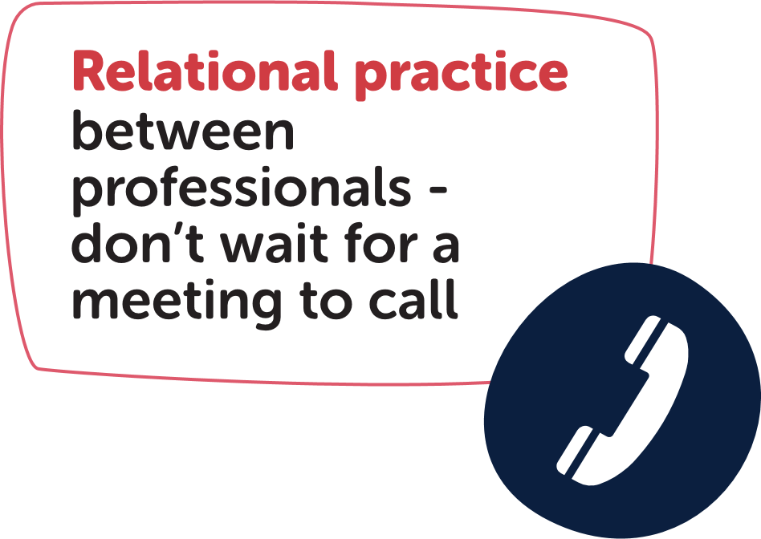
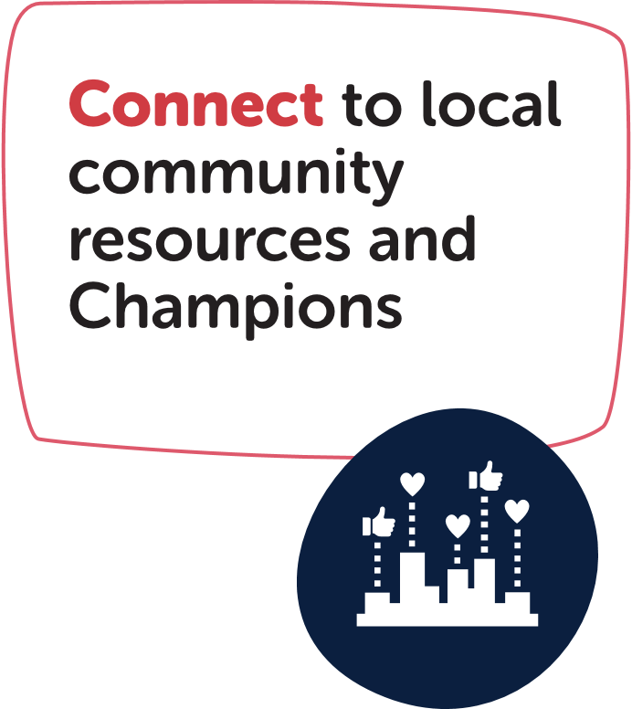



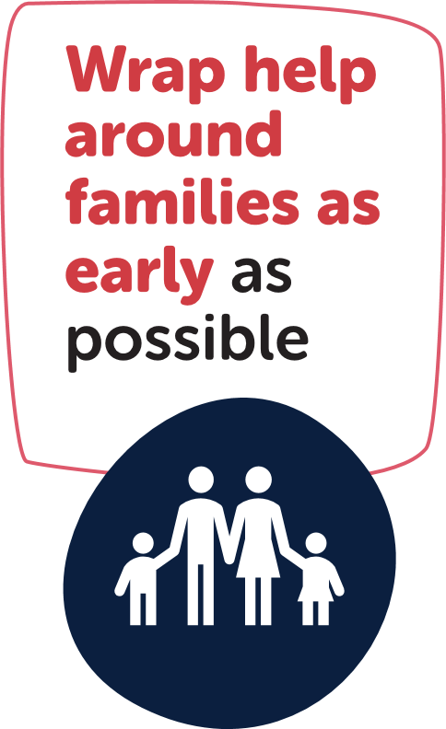

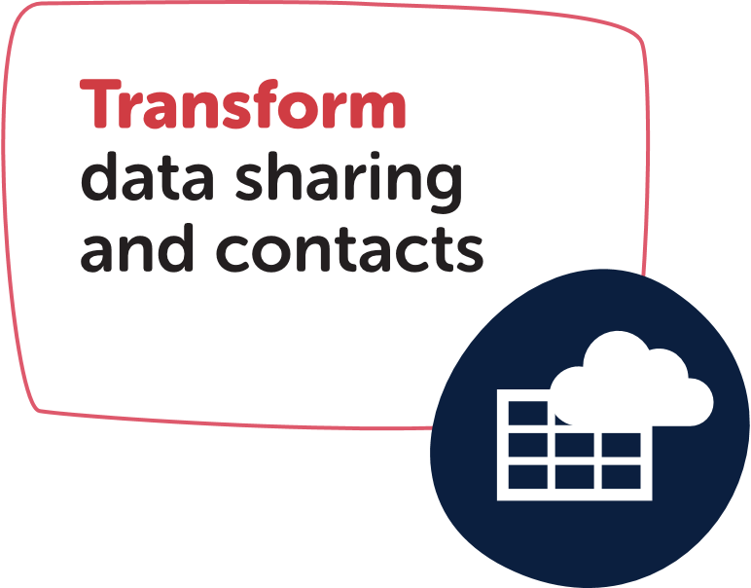


Professional Practitioners in school pilot
Team Around the Child meetings as needed
Frequent Team
around School meetings
FIS professional practitioners deployed to 12 secondaries
Notes:
We are putting a new and more effective model in place for the Team around the School – drawing from national practice and evidence from places such as Kent.​
For staff in schools, it’s important to know who your named professional is, and be able to pick up the phone to have a conversation. Contact details are on the Transform Family View app.
​
Team Around the School named professionals might include:​
Champion​
FIS team manager​
Inclusion team​
Relationship manager​
Mental health support team (if applicable)​
Later we may be able to add:​ Police PCSO​, Village and Community Agents​, Local VCFSE​.
​
Important to be building local human relationships so we can better wrap around families.

Slide 20
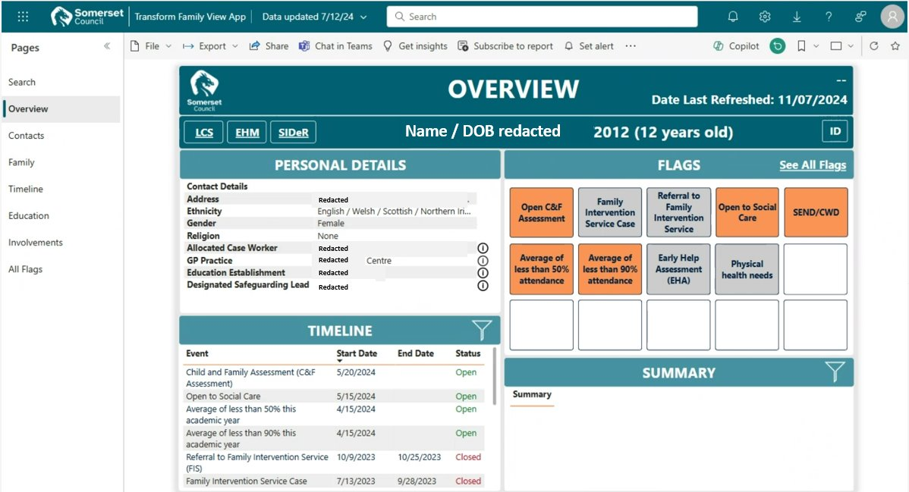
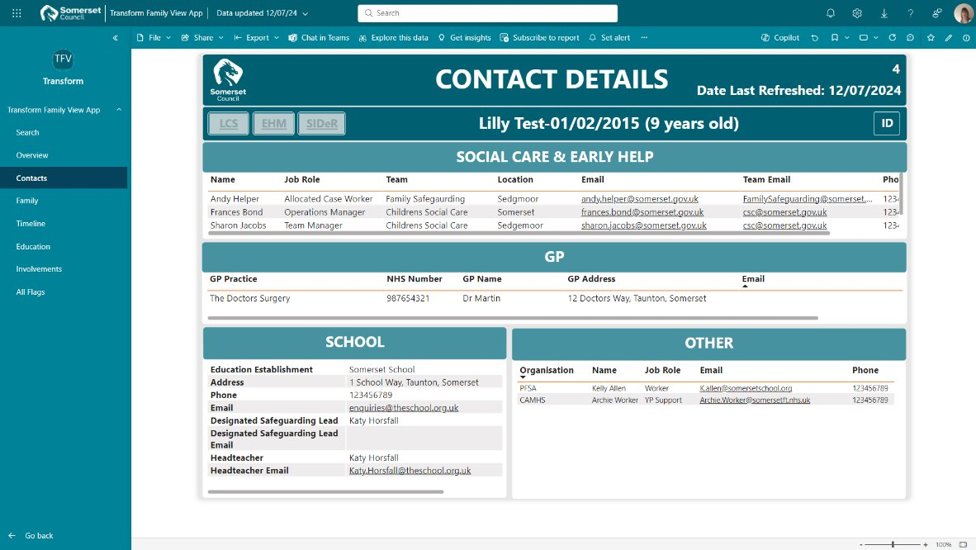
Transform Family View
Transform Family View is Somerset’s solution to joining-up fragmented children’s services data systems
It surfaces data in one place, joining up the early help system, by showing involvements with other professionals
It identifies risk, harm and threat
It is fully automated, pulling data in from multiple sources, matching the single individual’s vulnerabilities to their family members
It gives a holistic view of the family’s complexities in one place for the first time
Notes:
Why?
Understanding the life of a child and their family has historically been a challenge
Poor or non-existent information sharing is a factor repeatedly identified as an issue in case reviews
What is Transform Data View?
Transform Data View is Somerset’s solution to joining-up fragmented case management systems
It surfaces data in one place, joining up the early help system, by showing involvements with other professionals
It is fully automated, pulling data in from multiple sources, matching the single individual’s vulnerabilities to their family members
It gives a holistic view of the family’s complexities in one place for the first time.
It identifies risk, harm and threat
Want to know more about it?
Please contact Joanne.Harris@somerset.gov.uk for further information
Note, Somerset is a national leader in children’s services data! DfE funded us to write national guidance and are paying for us to support 30 other local authorities!

Slide 21






Neighbourhoods
Drivers
Working in partnership – to co-ordinate services, local activity, networks and create opportunities to bring people together
Rising Complexity
Rising Demand
Efficiency
Community and resident led – co-designing and evolving the 100-hub model with our residents and communities
Design Principles (enablers)
Growing stronger communities – able to support one another, enabled by a strong VCFSE offer. Residents and professionals understand local resources
Deliver services in neighbourhoods
Build relationships
Integrated services, multi-disciplinary teams – relationship and strengths-based approached that tackle issues holistically
Symbiotic relationship between public sector and communities
A workforce who feel connected – who are well networked working flexibly in neighbourhoods across physical and virtual space
Professionals &
Community in the same team within a neighbourhood
Each neighbourhood will develop differently
Preventing issues arising by addressing them early – tackling inequality, through more integrated public services and more resilient local communities
Integrate estate and management
Notes:
Somerset children’s services, adult services, NHS Integrated Care Board and Somerset Foundation Trust are shifting parts of our delivery to neighbourhood teams, to help us join up and work more closely with local communities. In each neighbourhood we will build relationships with the local primary care trust and link up across children’s and adults, people and place, health and care. Each neighbourhood includes Connect Somerset Champion, Parent and Family Support Advisers and CCS Village and Community Agents.
What’s a neighbourhood team? A neighbourhood team is a multi-agency group of professionals who operate from the same local geography. For families and residents, this might mean you can access support from several professionals at the same location, or perhaps one professional is able to provide multi-disciplinary support.
Why community hubs? We have at least 100 hubs across Somerset, alongside the 12 core Connect Somerset hubs. Where families and residents get help from a community hub, it can feel more inviting, like it’s part of the community. By delivering through community hubs, we’re able to reach a larger proportion of the population, as well as linking up better with local community resources, voluntary sector and groups.
How could we join up? It will take time to identify where we can join up with Adult services, the NHS and voluntary, community, faith and social enterprises (VCFSE). Also, this is likely to be different in each neighbourhood. We are already bringing together the data systems, we may also introduce a shared case management system. It will be important that we measure the same data as our partners to understand the impact of changes. We share some buildings already, there are opportunities to have the same office and delivery space. And there are some processes that may work better together, for example safeguarding, triage, identifying who needs help.
Which neighbourhood am I in? We have 12 neighbourhoods and six localities in children’s services, 12 neighbourhoods in adults and 13 primary care networks that are the basis of neighbourhood teams in health. These geographies are coterminous, i.e. the boundaries are aligned. There are some minor differences such as Taunton being split into two in adults but one in children’s. It’s important that all boundaries are fuzzy as we’ll work across these lines, especially where that makes sense for children. Details of hubs are at connectsomerset.org.uk/my-community/community-hubs.

Slide 22
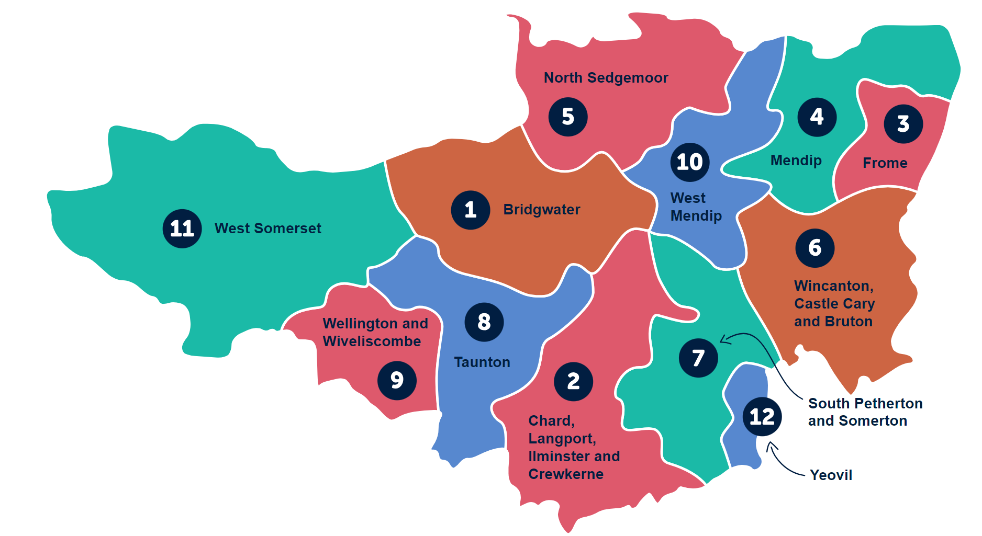
Neighbourhood Teams
DRAFT
The right spatial level
for effective delivery
Area & Locality
Social work and FIS locality teams
Relationship managers
Inclusion partnership managers
Family safeguarding
Children with disabilities early support
Youth justice
Neighbourhood FY24/25
Connect Somerset Champion
FIS team leader and team
Education support teams
CCS village and community agents
Parent and Family Support Advisers
1 x Somerset
4 x Areas
6 x Localities
12 x Neighbourhoods
Link to Primary Care Network team?
Link to Adult services?
Link to Mental Health?
Health Visiting and School Nursing?
One Team?
Housing?
Local VCFSE?
Neighbourhood FUTURE ??
Note that neighbourhoods and localities are for operational delivery, whilst local community networks are for engagement and governance
Notes:
Not everything is best in a neighbourhood. Some services will continue to be County-wide or delivered in four areas.
We are testing out what works best at which spatial level, and neighbourhoods will continue to develop and evolve over the next few years.
Note, there are 18 Local Community Networks (LCN) that are designed to improve local engagement and offer local political governance. Neighbourhood teams are operational, although work closely with their LCNs.

Slide 23


What are community hubs?
  A significant change in the way we respond to need through local solutions and prevention
  A way to manage long term demand and reduce duplication in service delivery to reduce costs
  Hubs are where local residents feel comfortable – that might include local libraries, warm spaces or community hubs
  Hubs are strengths-based, multi-disciplinary, enable the workforce, and foster resident, family and community connections and resilience
  Driven by data and insight – identifying residents at risk and those who may benefit from early intervention
  Focused reducing issues which drive acute need and crisis (e.g. debt and financial hardship, evictions, domestic abuse)
  Proactively remove barriers and address inequities in access, experience and outcomes affecting our local communities
  Evolving in response to data, experience and learning
  Hubs are not:
  One stop shops – as every area is different
  Area offices – although staff may have access to flexible desks
  A new service offer – hubs will bring existing services together
Notes:
Community hubs are an important part of Connect Somerset – to enable services and support to be accessed closer to home.
There are around 100 community hubs across the County – if we deliver from all of these, we will reduce the impact of rurality and inequality.

Slide 24
Timeline
Notes:
Every plan is wrong as soon as it’s written, but this is our best stab at the timeline of development until 2030.

Slide 25
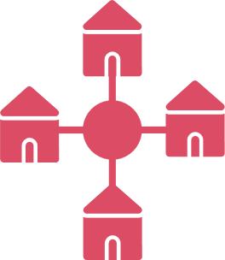






Workstreams
Build neighbourhood teams
Evaluate impact
Team Around the Child (TAC)
Comms to 20-30,000 professionals
Digital Universal and SEND Local Offer
Automated Early Help
100 Hubs community offer for information, advice and support
Notes:
The Connect Somerset transformation has a comprehensive programme plan overseen by the Connect Somerset Steering Group (with cross-sector representation), and r porting to the Children’s Services Transformation Board and Children, Young People and Families ICS Board (which reports to the Somerset Board).
There are seven worksteams:
Build neighbourhood teams
Team around the child
Digital universal and SEND local offer
100 Hubs community offer
Automated early help
Comms to 20-30,000 professionals
Evaluate impact

Slide 26
Build neighbourhood teams
Still to do…
Working with partners to map out existing provision at a neighbourhood level including 100 local hubs
Develop Early Help processes and alignment across children's and adult services
Steps forward…
Developing children’s services neighbourhood teams aligned with Adults, SFT and PCNs
Piloting of the Wincanton postie knock and care pilot in partnership with Somerset partners and Royal Mail
Pilots in Wincanton and West Somerset, bringing together workforce, e.g. Champs, FIS, SEND, PFSA, CCS Agents, Inclusion and Relationship Managers
Notes:
Build neighbourhood teams so professionals work better together, and families and residents can access support in a more integrated way. Starting with Champions, CCS Village and Community Agents, Parent and Family Support Advisors, Family Intervention Service, SEND support services and growing from there. Many Council and Health services could be in the neighbourhood teams in the future — delivering support closer to home, more efficiently and better integrated. Neighbourhood teams are aligned to primary care networks, adult and children’s services, although boundaries will always be fuzzy.

Slide 27
Team Around the Child (TAC)
Still to do…
Working with system partners to understand the VCFSE offer at a neighbourhood level (Community Around the School)
Greater awareness of TAS in schools and partner organisations and building relationships between local professionals
Further development of Transform Team Around the School module and associated products
Sustaining PFSA funding for 2025/26+
Considering Transform Family View for adults services
Steps forward…
Go live of the Transform Team Around the School modules
Go live of Transform Family View (TFV)
Engagement and roll out of TFV with Social Care
Local engagement with education partners on Transform
PFSA business case and secured funding for 2024/25
Notes:
Team around the Child — setting up a new virtual team bespoke to each school that is there to support staff and help for pupils and their families. The Team Around the Child is designed to promote relational practice — so professionals get to know each other working in a patch, draw on community resources and wrap support around families. We want to reduce exclusions, improve attendance and attainment.

Slide 28
Digital Universal and SEND Local Offer
Still to do…
Transform onboarding and training
Develop Transform Strategic Insight Report through area profiling
Roll-out of case management system including support and training
Early help assessment built into case management
Quality assurance of early help practice
Steps forward…
Development of the Connect Somerset website
Development of the SEND Local Offer
Creation of the SEND Local Offer Roadmap
Notes:
Our Digital Universal and SEND Local Offer is important to us as we recognise that all families need support from time to time to help their babies and children thrive. Many families and residents have little resilience to the challenges of the cost-of-living crisis that is hitting harder than previous periods of high inflation but by having a strong digital offer we are supporting more families and residents to self-service, giving them the confidences to build their resilience.

Slide 29
100 Hubs community offer for information, advice
and support
Still to do…
Partnership working on Social Prescribing Framework for Somerset
Supporting Social Prescribing week celebratory campaign
Co-production of grants pot criteria and route into funding via SCF
Co-production of ARF criteria and route into funding via SCF
Encouraging more funding into VCFSE organisations to increase early help
Steps forward…
Identified 12 Core Hubs we are working in partnership with
Go live of Yeovil based Independent Learning Centre
Recommission navigator/connector role, carers Service
Commission of #LearnForLove universal parenting offer
Coordination of #Help4ALL
Notes:
Hubs — we have a community hub in each neighbourhood, and there are 100 more hubs such as village halls where we want to deliver statutory and community services. The aim is to get services closer to home, and in places that the public are already at and feel welcomed. For example, the new SEND strategy includes a commitment to more local drop-ins through the 100 hubs.

Slide 30
Automated Early Help
Still to do…
Develop area profiles (TSIR) to quantify levels of vulnerability
H2HY digital front door solution “one version of the truth” ecosystem for information and guidance and directory of support
Establish CRM technology to deliver guidance
Develop service opportunities to use new digital relationships
Bring together and test population risk analysis (linked to area profiling), CRM and resource database
Steps forward…
Development of the Transform Strategic Insight Report (TSIR)
Engagement with education settings on Transform
Transform training
Transform development and onboarding
Options appraisal drafted for shared case management options
Consultation and engagement with partners to determine service user requirements for shared case management
Notes:
Automated Early Help – Through Transform Family View and Transform Strategic Insight Report we will develop our understanding of families’ and residents’ needs. By combining partner data, we can proactively offer early help before issues escalate — this will feel more compassionate than the rationing that residents sometimes experience. When we understand both needs and local community resources, we will be able to automatically connect residents to local support, sometimes without the need for a service. This is a step-change in the efficiency of early help.

Slide 31
Comms to 20,000 to 30,000 professionals
Still to do…
Children and Young People’s Plan – early help strategy refresh
Weekly comms to more partners and through more channels
Communication plans for new work, e.g. community grants, transform app, #Help4All, shared case mgt tool
Steps forward…
Development of comms plan, stakeholder list and identified channels to each sector
Weekly comms articles and blogs
Production of digital assets
#LearnForLove social media campaign
#Help4All social media campaign

Slide 32
Evaluate impact
Still to do…
Procure an evaluation partner to support the development of a logic model
Build in measures of impact to BAU systems
Explore the Social Value Engine
Meaningful engagement with service users
Steps forward…
Commitment with ICB colleagues to collaborate to evaluate impact of early help, personalisation and community-based design
Engagement on partner experience of Social Value Engine
Spec drafted in the procurement of an evaluation partner
Notes:
Through Connect Somerset we want to develop a sustainable integrated model of support in Somerset, where families and residents are more resilient, have strong networks and communities to help them, and an integrated response from services that is proactive and compassionate. We’re trying to do something quite different, and need to be able to evidence the impact on this way of working both in terms of improved outcomes but also to evidence the monetary return on investment.

Slide 33

Notes:
Go to www.ConnectSomerset.org.uk for more information and materials.

