Slide 1
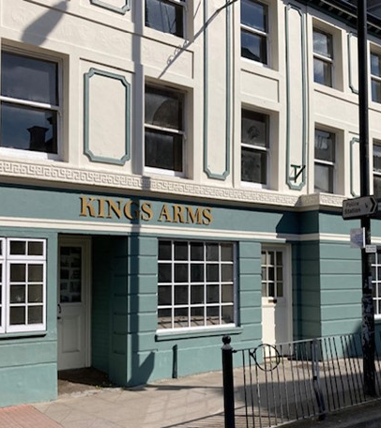
Connect Somerset Success Story
This week, Champion Peter shares how the community in Wellington are working together to develop a new early help hub.
“The Kings Arms building was empty for some time. Plans are already in place for the middle and top floor by Falcon Housing to provide affordable housing for residents of Wellington, leaving the ground floor as a space dedicated to the wider community needs. A working group, including Wellington Town Council, Churches Together, Spark, Falcon Rural Housing and the Connect Somerset Area Champion, has been set up to ensure the ground floor can be used to support the community and to discuss what could be provided. With an increase in demand for statutory services at present, it was agreed that an early help hub should be set up to support local adults, children, families and young people who may be vulnerable.”
“By working collaboratively, support will be available to address needs at the earliest opportunity, costs and expertise will be shared and escalation to statutory services can be prevented.”
www.connectsomerset.org.uk
hello@connectsomerset.org.uk

